Slide 1
IMPLEMENTING A BEHAVIORAL HEALTH CRISIS SYSTEM OF CARE
Lauren Anderson- Senior Manager of Clinical Operations- Providence
Eric Boyer Alaska Mental Health Trust Authority
Becky Bitzer, Thea Agnew Bemben Agnew::Beck Consulting
March 2024

Slide 2
GOAL: Design and implement a behavioral health crisis response system analogous to the physical health system.
Notes:
So, what does this look like in practice? The goal is to design and implement a behavioral health crisis response system analogous to the physical health system. If you fall and break your leg, you call 9-1-1, EMS responds, takes you to an ED and the ED can admit you to an appropriate unit if necessary. With Crisis Now, the same sort of system will become available for individuals in behavioral health crisis.

Slide 3
Notes:
Arriving at an initiative to transform behavioral health crisis care in Alaska grew out of studies completed in 2017 and 2018 related to psychiatric boarding in hospital emergency departments around the state and increasing wait times in correctional settings for individuals deemed incompetent to stand trial. Recognizing a need to reduce the number of individuals with behavioral health concerns being seen in hospital and correctional settings, and in conjunction with new services available under the 1115 waiver, the Trust contracted with RI in 2019 to conduct an assessment of Alaska’s behavioral health crisis system and begin to educate stakeholders about the Crisis Now framework. In 2020, the Trust contracted with Agnew::Beck to provide project management support to the initiative. Agnew::Beck developed a workplan based on the recommendations in the RI report that addresses community and systems level objectives, and convened a series of stakeholder workgroups in Anchorage, mat-Su and Fairbanks to support community understanding of the framework and how it might build on or enhance existing community resources. Since those original workgroup meetings, the Trust has funded community coordinator positions in three communities, mobile crisis teams have launched in Anchorage and Fairbanks and HB 172 passed, paving the way for no-wrong door crisis stabilization outside of a hospital setting. We’ll hear more about these accomplishments and the amazing working happening in our communities later today, but for now, we’ll provide more context for the work happening around the state.

Slide 4
Systems Supports
Workforce: Developing a training toolkit for crisis service operators
System Monitoring: Developed logic models for three service levels to help programs and systems plan strategically to achieve long-term outcomes
Advocacy: Priorities include –
Overtime exemptions for all care team members in sub-acute mental health facilities
Clarification of requirements in temporary licensing application
Sustainable funding for crisis services to supplement 1115 Waiver billing
Notes:
At the systems level, some initiatives Agnew::Beck and the Trust are supporting include development of a trailing toolkit for crisis service operators, development of logic models and a performance monitoring plan for each service component to help organizations and communities think strategically about the data they will need to collect to inform service and system performance and identification of advocacy priorities including….

Slide 5
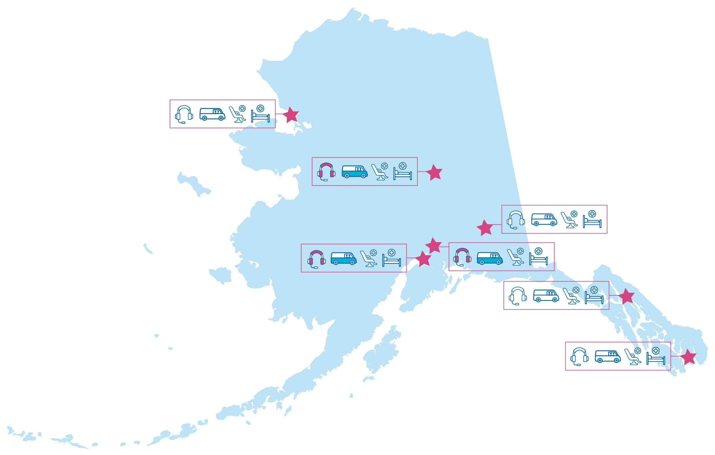
Crisis Now Implementation At a Glance
Crisis Now planning and implementation underway in:
Anchorage
Mat-Su
Fairbanks
Juneau
Ketchikan
Kotzebue
Copper Basin
Notes:
In 2019, the Trust started planning in 3 communities: Anchorage, Mat-Su and Fairbanks; Now community-level planning efforts are underway in Juneau and Ketchikan, service implementation planning is occurring in Kotzebue (MA), in the Copper Basin (Copper River Native Assoc MIH), plus initial conversations in Kenai, Unalaska, Prince of Wales

Slide 6
Community Adaptations
Community | Call Center* | Mobile Crisis | 23-Hour | Short-Term | Involuntary Psychiatric Tx. Beds
Anchorage | 911 transfers calls to Careline | Clinician + EMT/paramedic | Voluntary and NED, no rejection & | Voluntary and involuntary & | Yes, DET
Fairbanks | 911 transfers calls to Careline | Clinician + Peer & | Voluntary only, low barrier | Voluntary only | Yes, DET
Juneau | 911 transfers calls to Careline | MIH | Voluntary only; youth and adults | Voluntary only; youth and adults | Yes, DET
Ketchikan | TBD | MIH | TBD | TBD | No, DES only
Mat-Su | 911 transfers calls to Careline | Clinician + Peer & | Peer living room model | Voluntary only | Yes, DET
*Careline does not provide MCT dispatch in any communities to date. Where MCTs exist, 911 dispatches those teams.
Key:
Green text = operational
Black- in process
&= Full alignment with Crisis Now framework requirements
Notes:
We started with the framework of Crisis Now, but part of the community-level work is adapting that to the needs and resources of eachcommunity or region. I won’t go through all of this in detail, but want to highlight a few areas of working happening in these communities:
- For of the five communities have started transferring calls to 911 that meet identified criteria to the Alaksa Careline, instead of dispatching an emergency services response. Careline also recently opened a satellite office in Wasilla – historically only having a physical presence in Fairbanks.
- In Anchorage: SCF + Prov still working towards opening programs – you’ll hear more from Lauren Anderson with providence shortly; APD has added more capacity to their co-response Mobile Intervention Team – social worker and police officer and AFD is also staffing up to provide more coverage via the MCT (clinician and EMT/paramedic)
Fairbanks: Community is really invested in brining a no-wrong door model to the community. The current provider provides low-barrier access to 23-hour crisis stabilization and offers crisis residential services but only for voluntary individuals.
- As you’ll see here, Juneau and Ketchikan are preparing to use the mobile integrated health model with a behavioral health component as their mobile response strategy.
A lot of great work happening around the state and just really want to appreciate the providers and community coordinators who are putting in countless hours to bring this new services online in a coordinated way.

Slide 7
To learn more or get involved:
Learn more about the initiative on the Trust’s website
LaurenAnderson- lauren.anderson@providence.org Senior Manager of Clincial Operations- Providence Alaska Medical Center
Sign up to receive quarterly newsletters and invitations to webinars on best practices, workforce development and other key implementation areas – Email becky@agnewbeck.com
Participate in your local community workgroup. Workgroups convening in Anchorage, Mat-Su, Fairbanks, Juneau and Ketchikan – Email becky@agnewbeck.com
Contact the Trust to learn about technical assistance and funding available to support development of crisis and post-crisis services – Email eric.boyer@alaska.gov
Notes:
Before I turn it over to some of our providers on the call today, just wanted to share some key contacts and opportunities to continue engagement in this work.

