Slide 1
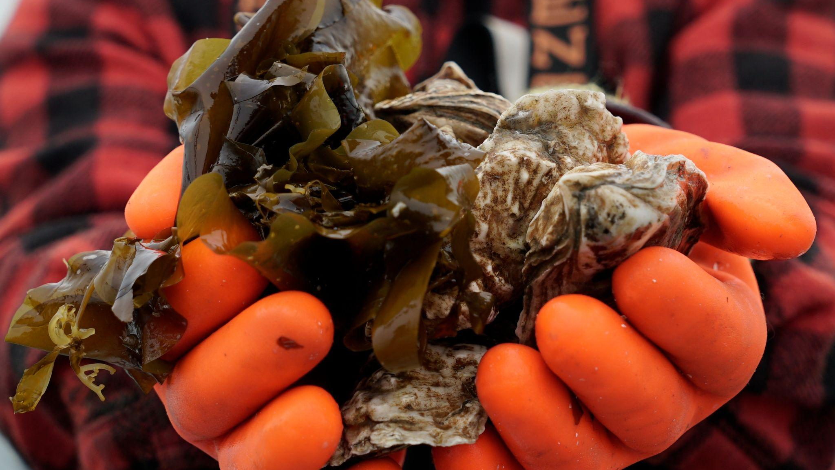
GreenWave
Farmer-Forward Programs
SWAMC Annual Conference | March 7, 2024
Lindsay Olsen
Director of Training & Support
Notes:
Hi all - my name is Lindsay Olsen and I’m the director of Training & Support at GreenWave. I’m based down in Homer where separately from my work at GreenWave I help run a small kelp and oyster farm with my family called Spinnaker Sea Farms in Kachemak Bay – and through my role as a farmer, I sit on the AMA board.
But today I want to talk to you with my GreenWave hat on, and specifically about what resources, programs, and opportunities of collaboration we offer for farmers, hatchery operators, and folks in the mariculture industry in Alaska.

Slide 2
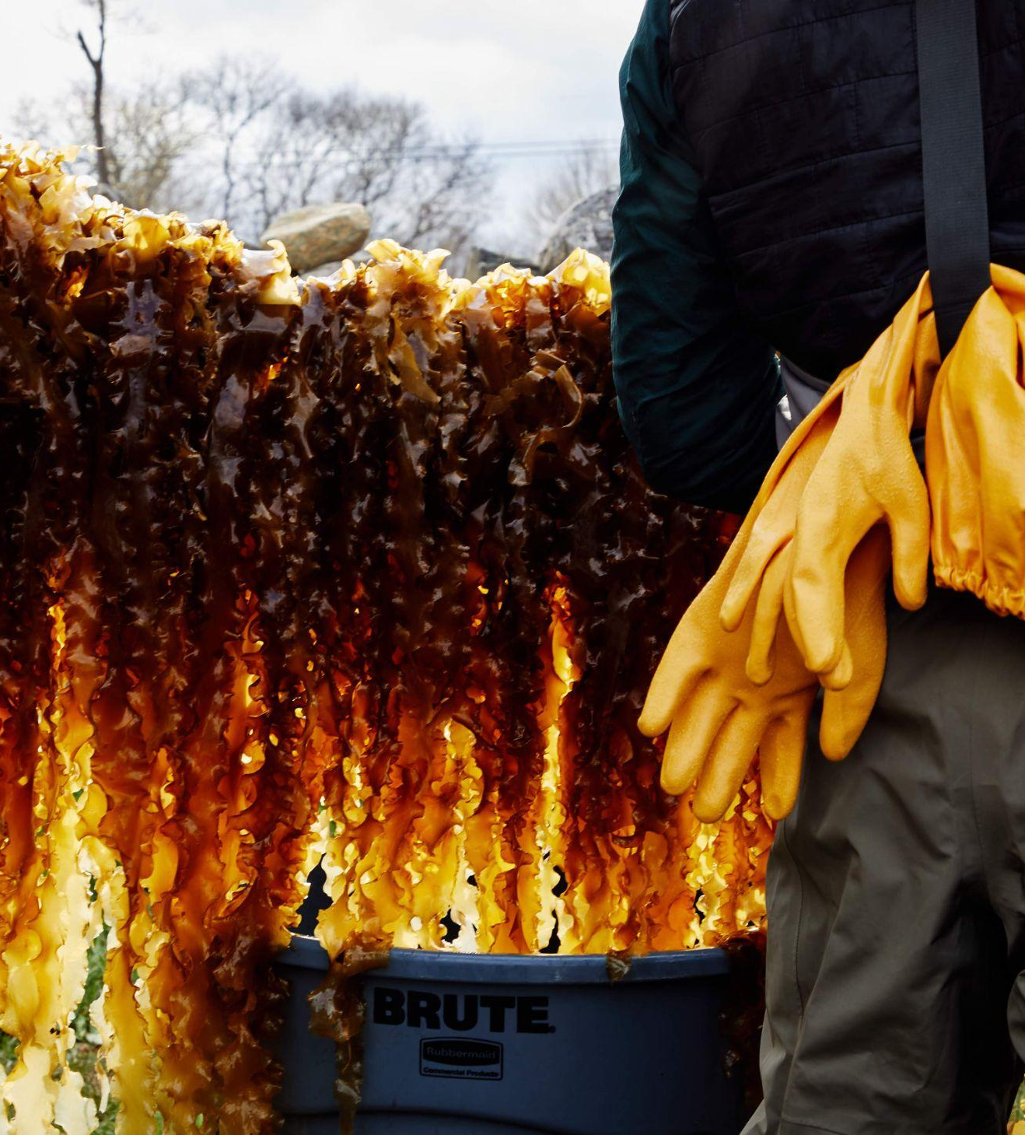
We train and support regenerative ocean farmers in the era of climate change.

Slide 3
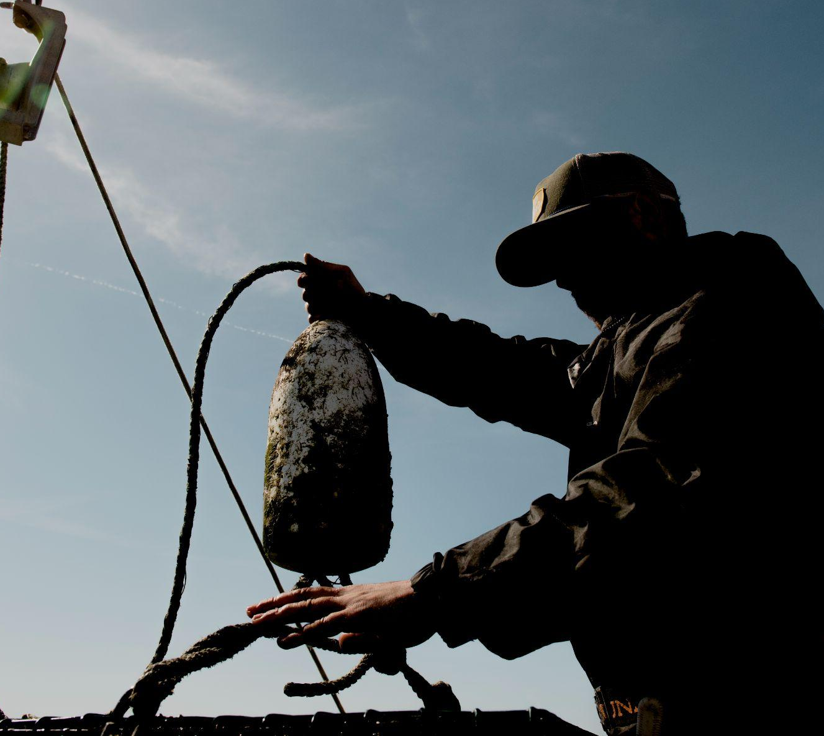
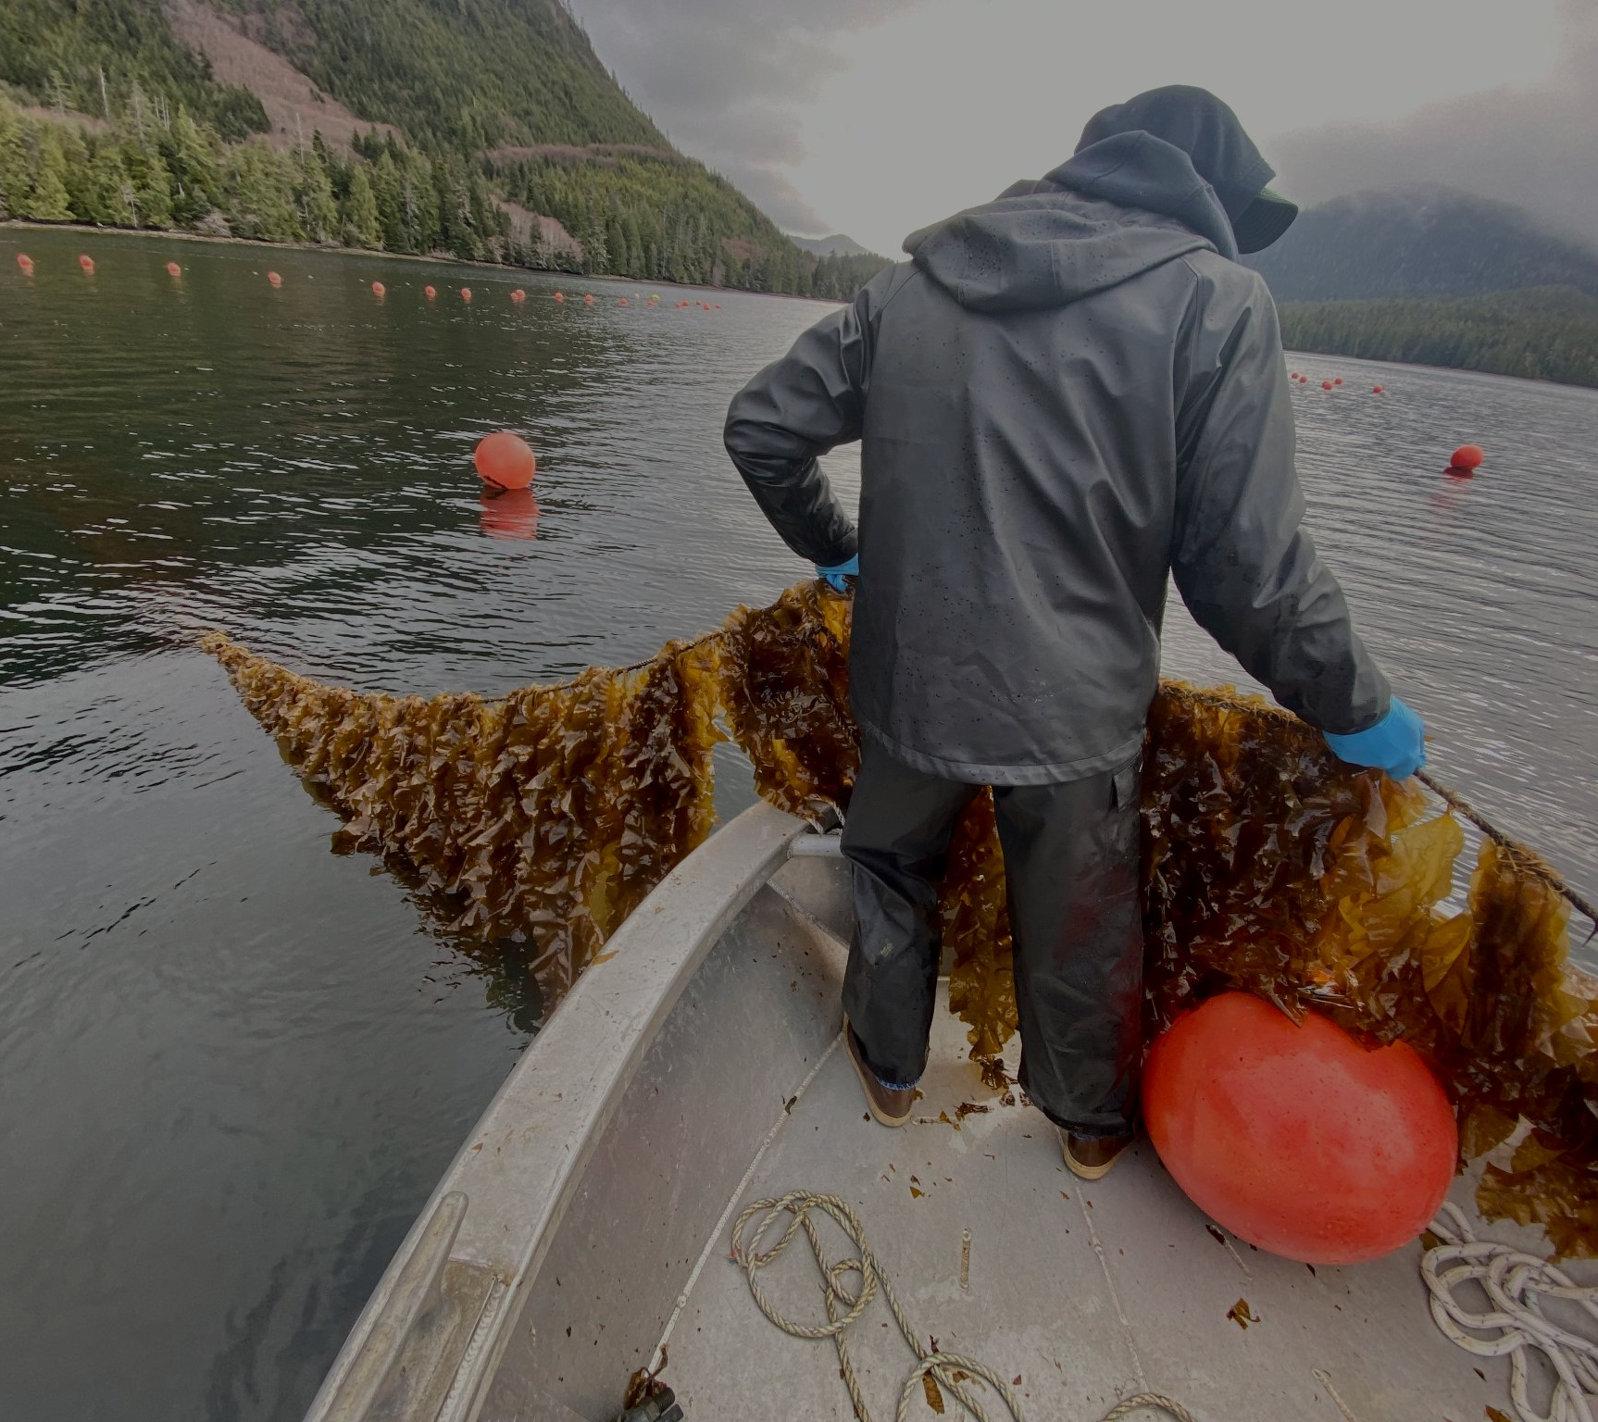
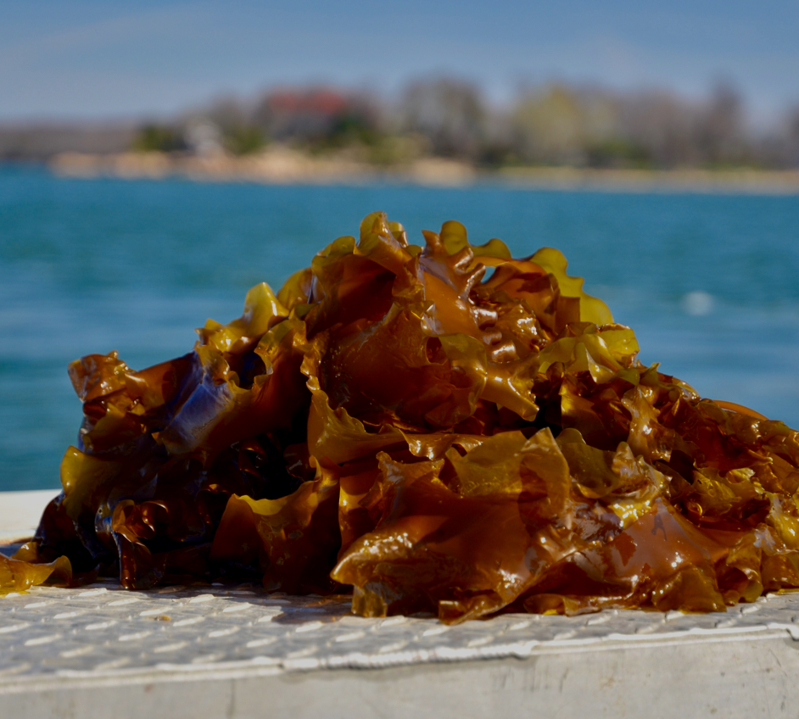
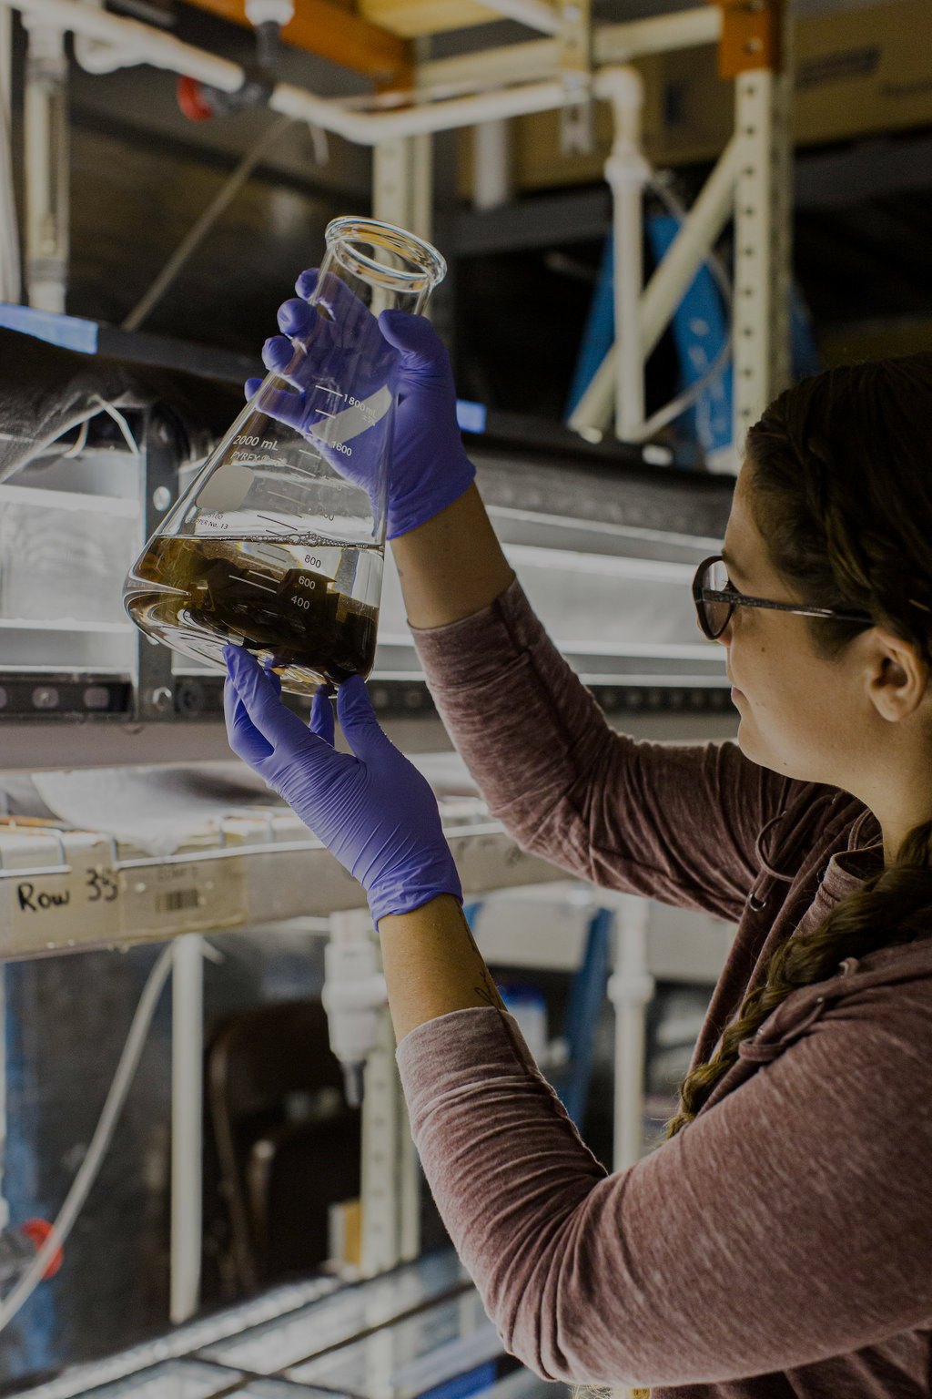
Program
Areas
Training & Support
Climate Subsidies
GreenWave identifies barriers to growth, develops solutions, and disseminates best practices back to the field through four program areas
Market Development
Farmer
Infrastructure

Slide 4
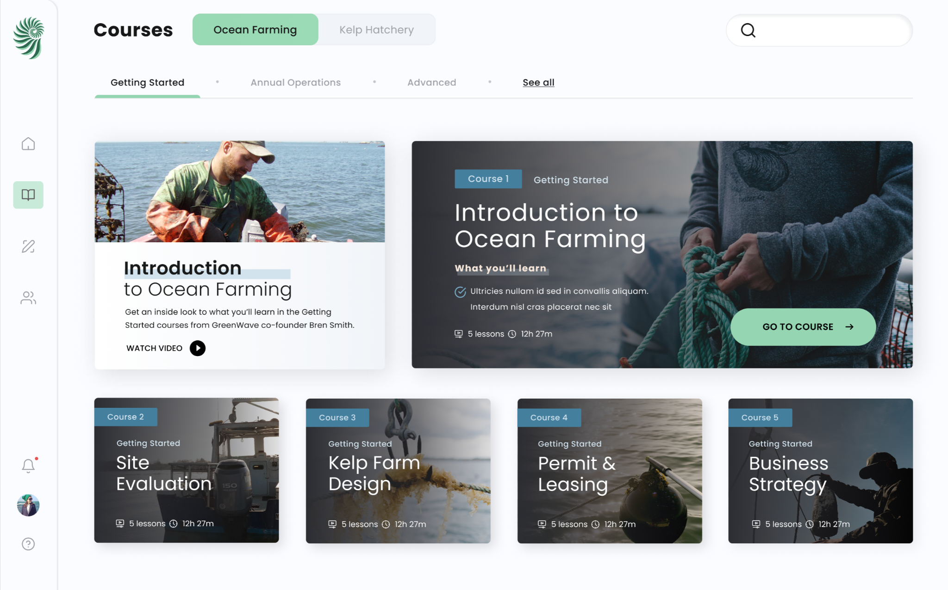
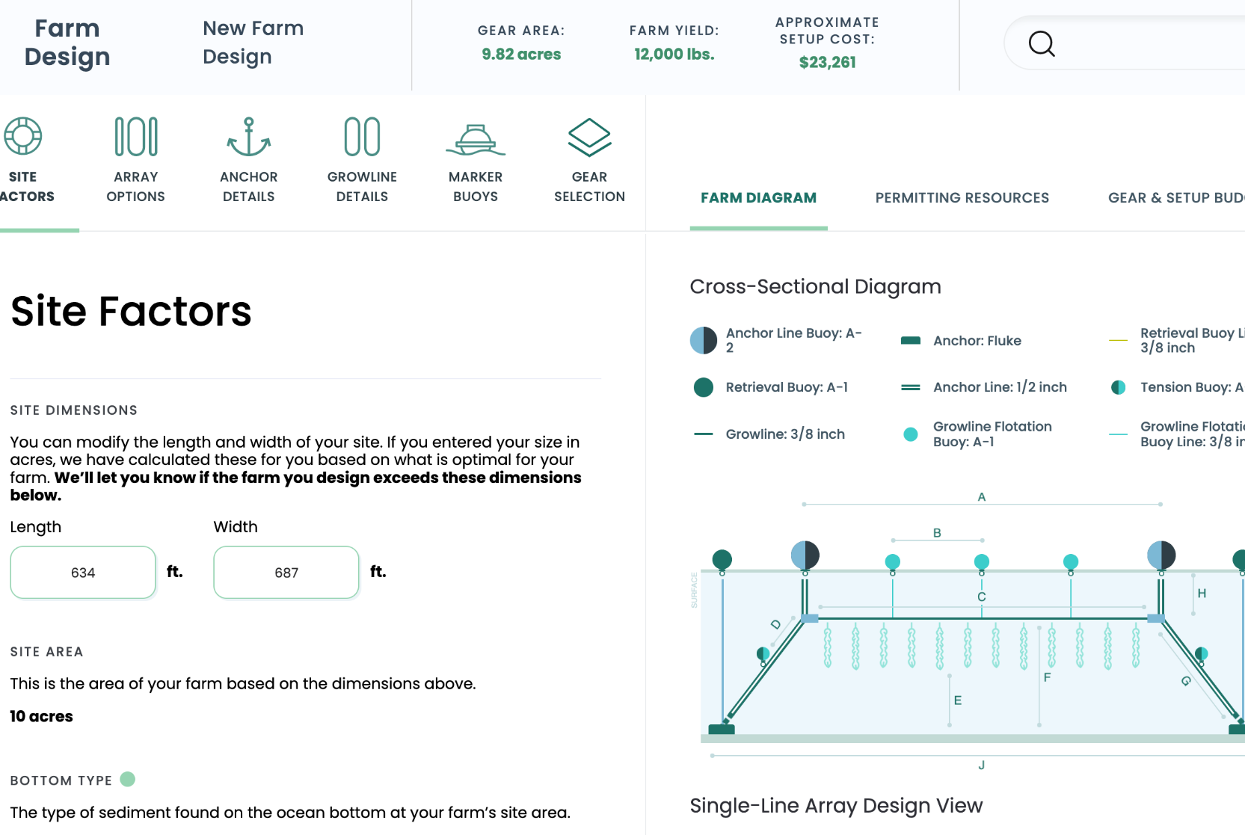
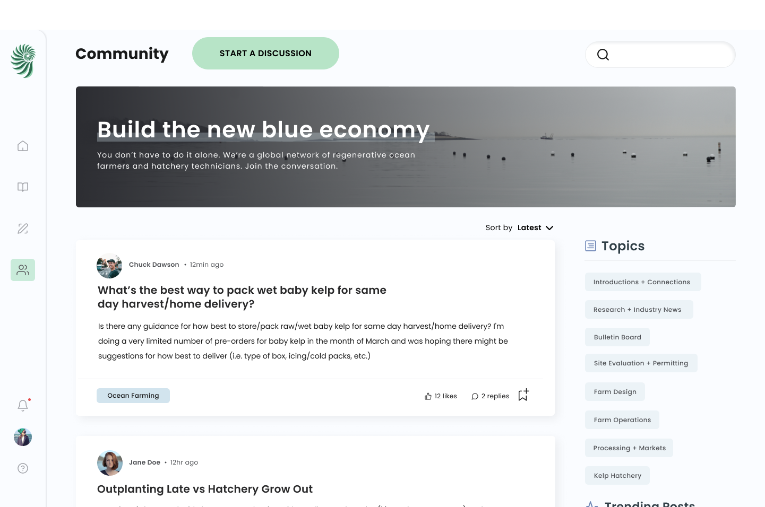
Ocean Farming Hub
Since April 2022
6,000+ USERS 2,200+ POSTS
Scaling Training & Support for Regenerative Ocean Farmers
TRAINING
TOOLS
COMMUNITY
Courses and 80+ how-to videos to launch and grow your ocean farm or hatchery
Interactive farm designs, budgets, and gear lists to build your farm
Collaborative space to solve technical questions and innovate
How to Start a Kelp Farm: 1,300 Registrations

Slide 5
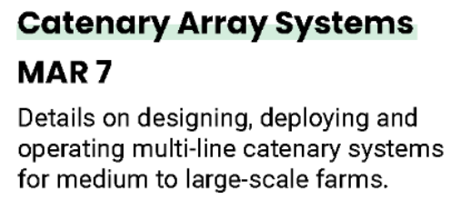

Slide 6
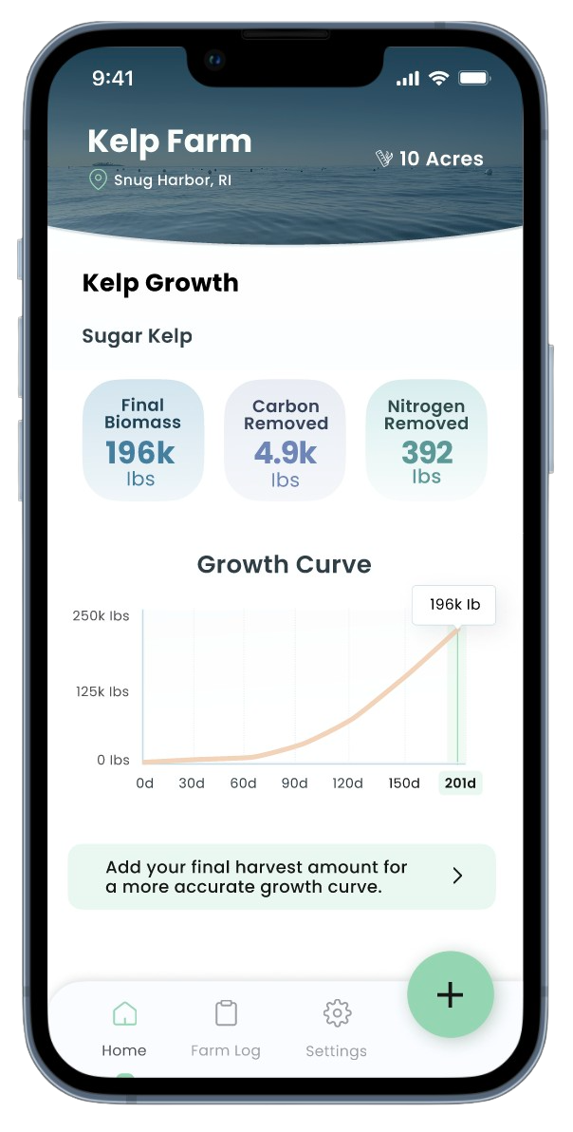
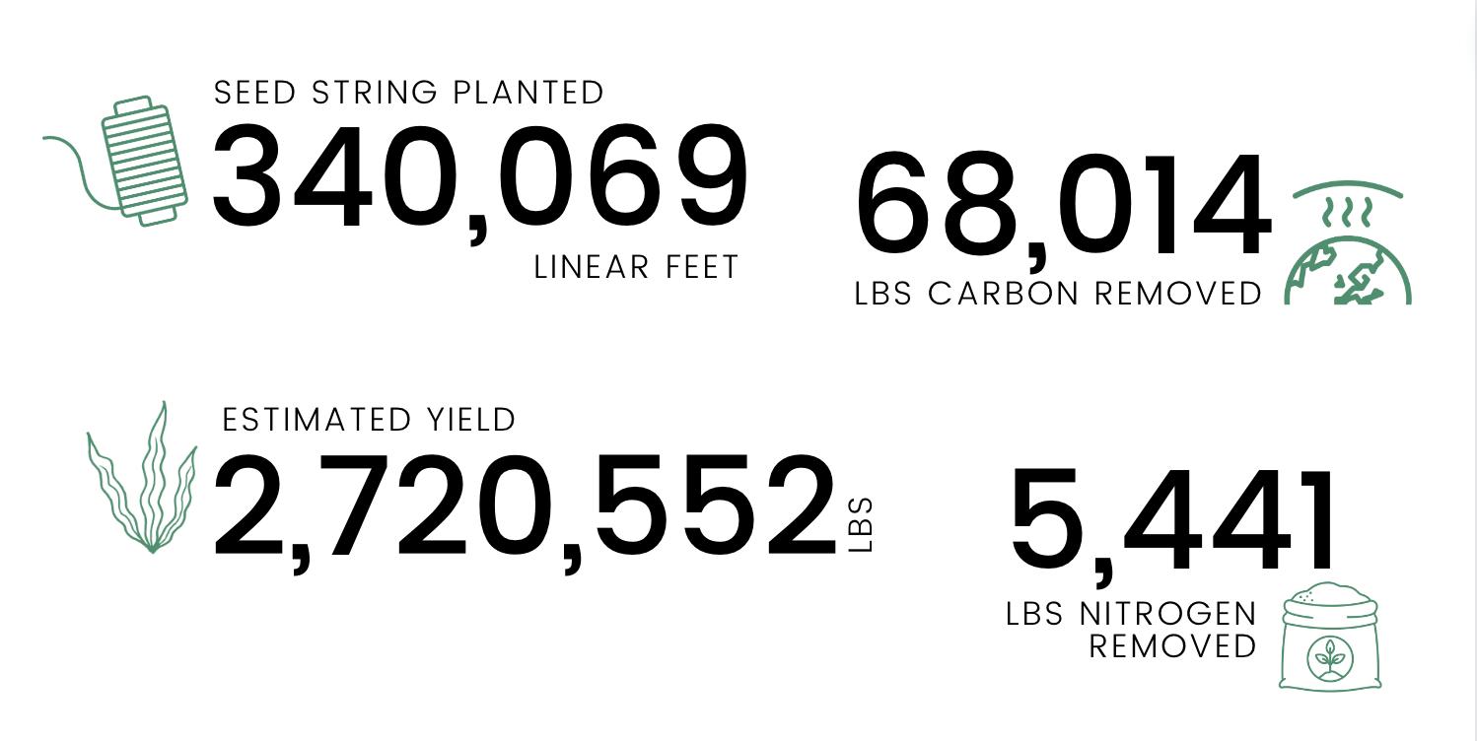
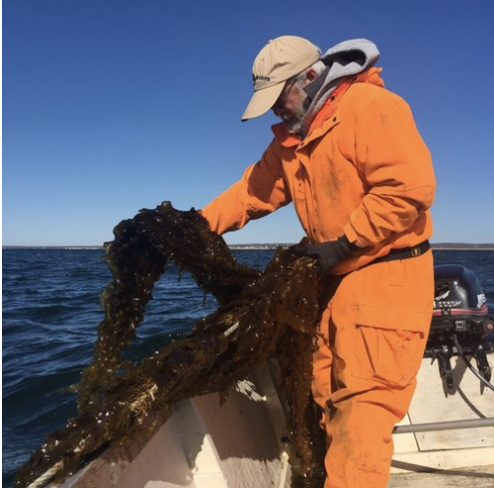
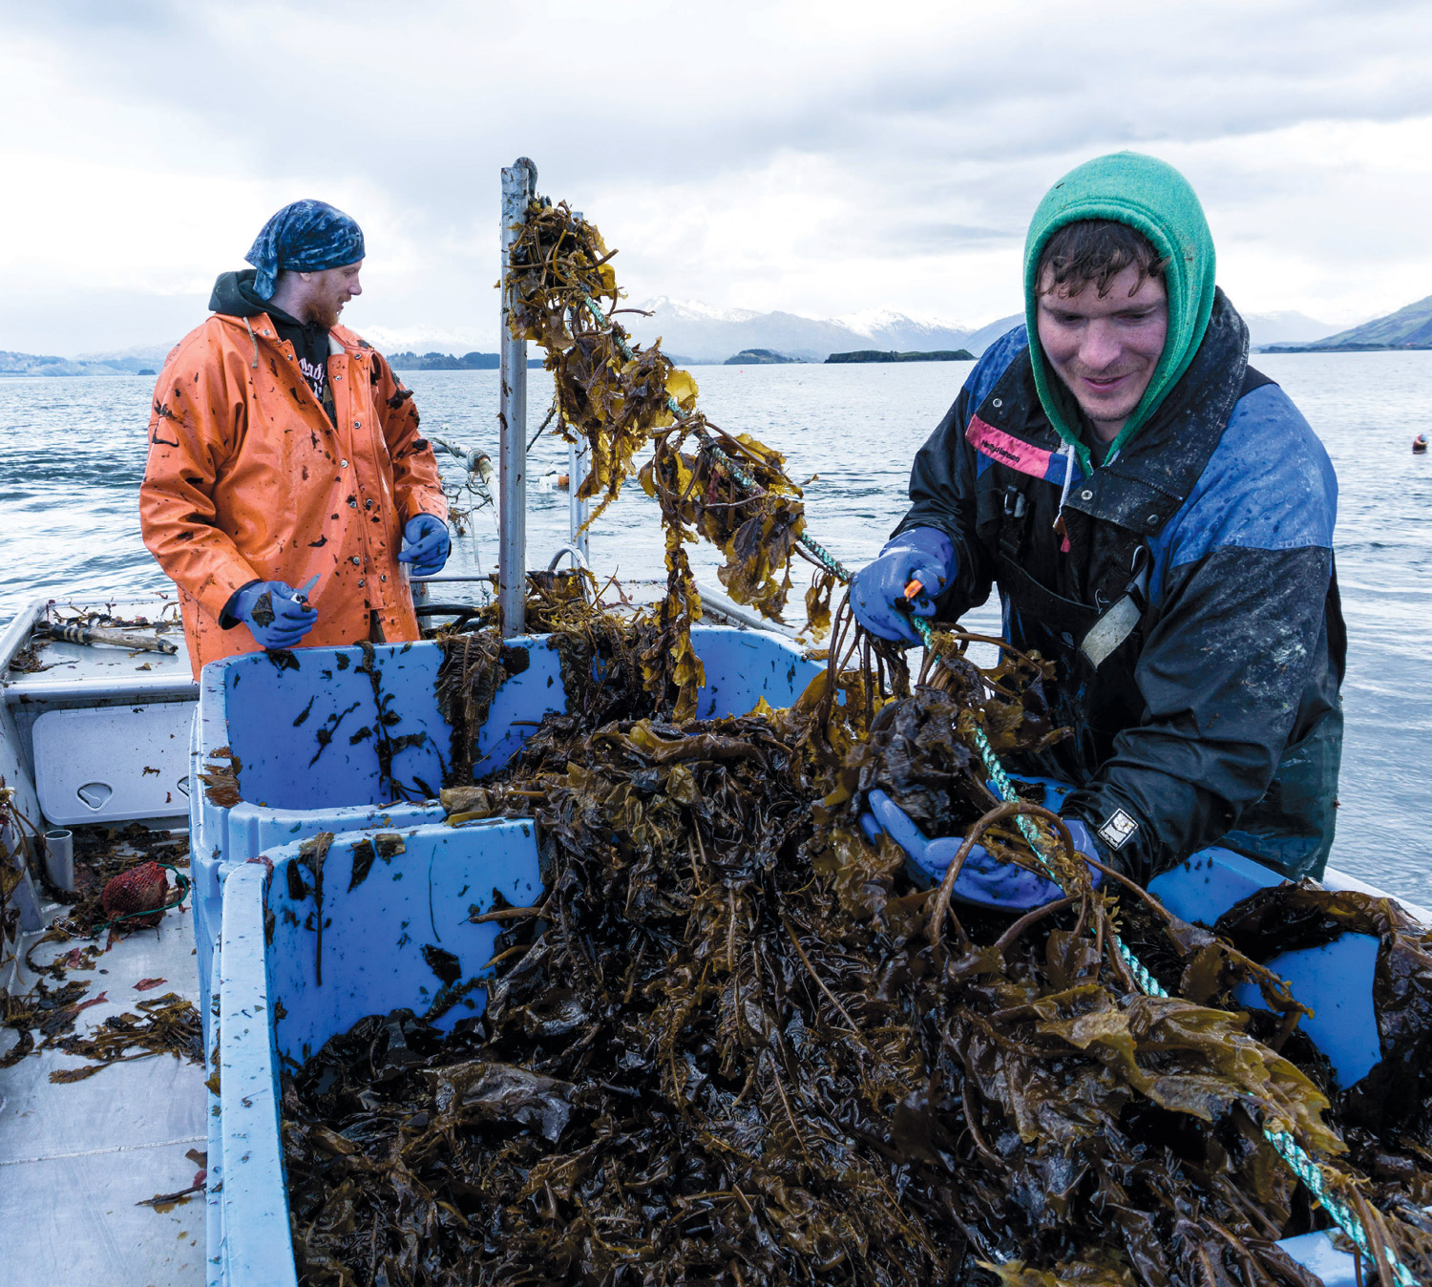
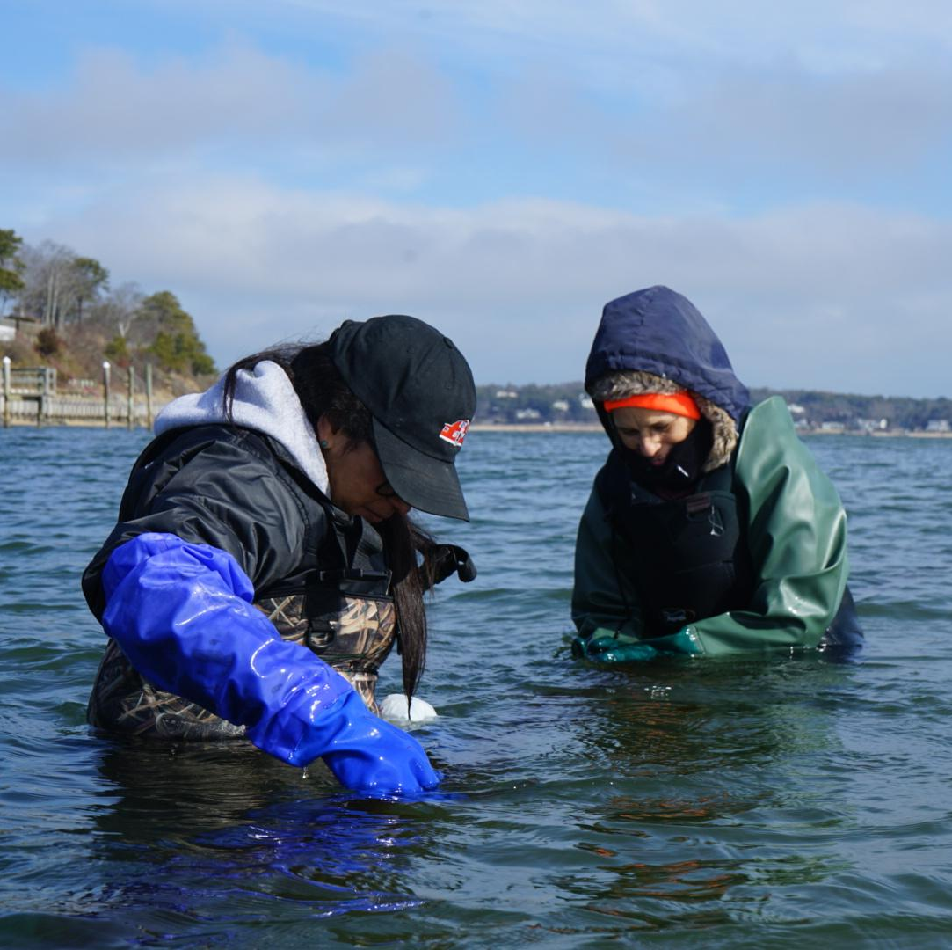
Kelp
Climate
Fund
Getting ocean farmers paid for the environmental impact of their work
2024 season: 47 farms, $500k+
Notes:
Use: goal: scale, safetynet, farmers love app

Slide 7
Seaweed Source
Market Development
Direct buyer engagement and digital platform opens new sales channels for small and medium-scale farmers
59
PARTICIPATING COMPANIES
444K
LBS FORWARD CONTRACTED

Slide 9
Farmer
Infrastructure
Seed Production Regional farmer owned seed banks
and nurseries

Slide 10
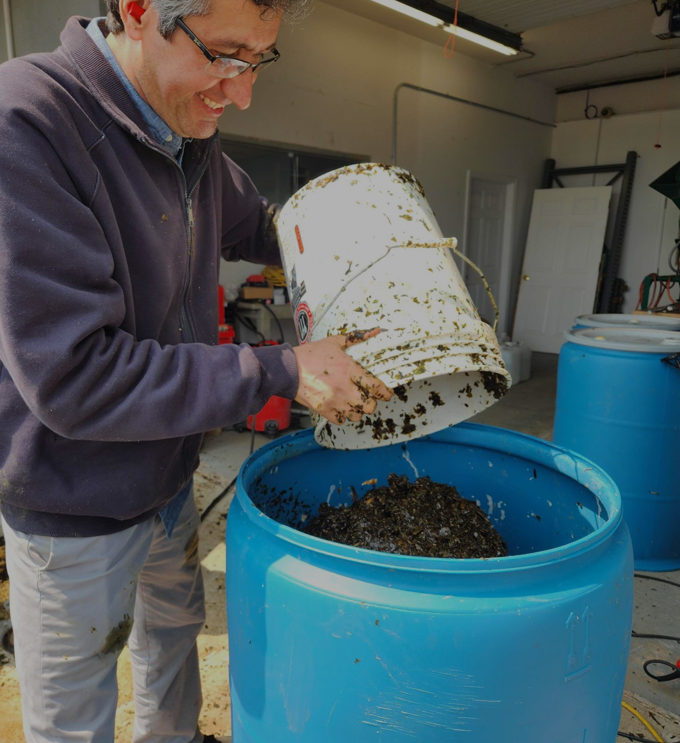
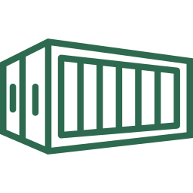
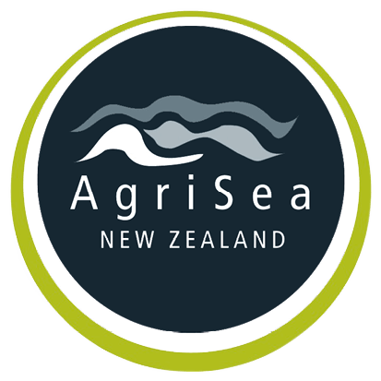
Farmer
Infrastructure
Seed Production Regional farmer owned seed banks
and nurseries
Processing Crop stabilization for ingredient and agricultural markets

Slide 11
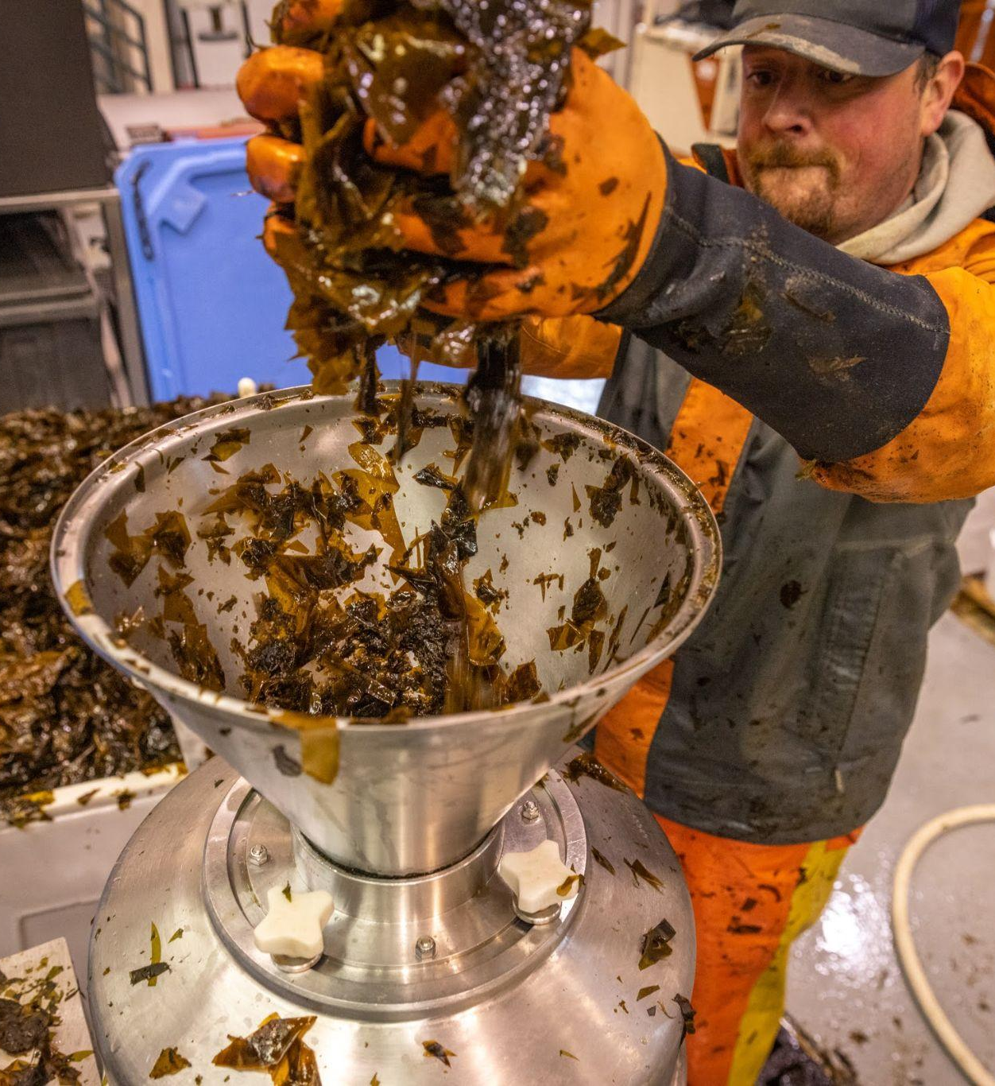
Farmer
Infrastructure
Seed Production Regional farmer owned seed banks
and nurseries
Processing Crop stabilization for ingredient and agricultural markets
Technology Transfer
Demonstrations & grants for farmers to scale hatchery and processing capabilities

Slide 12
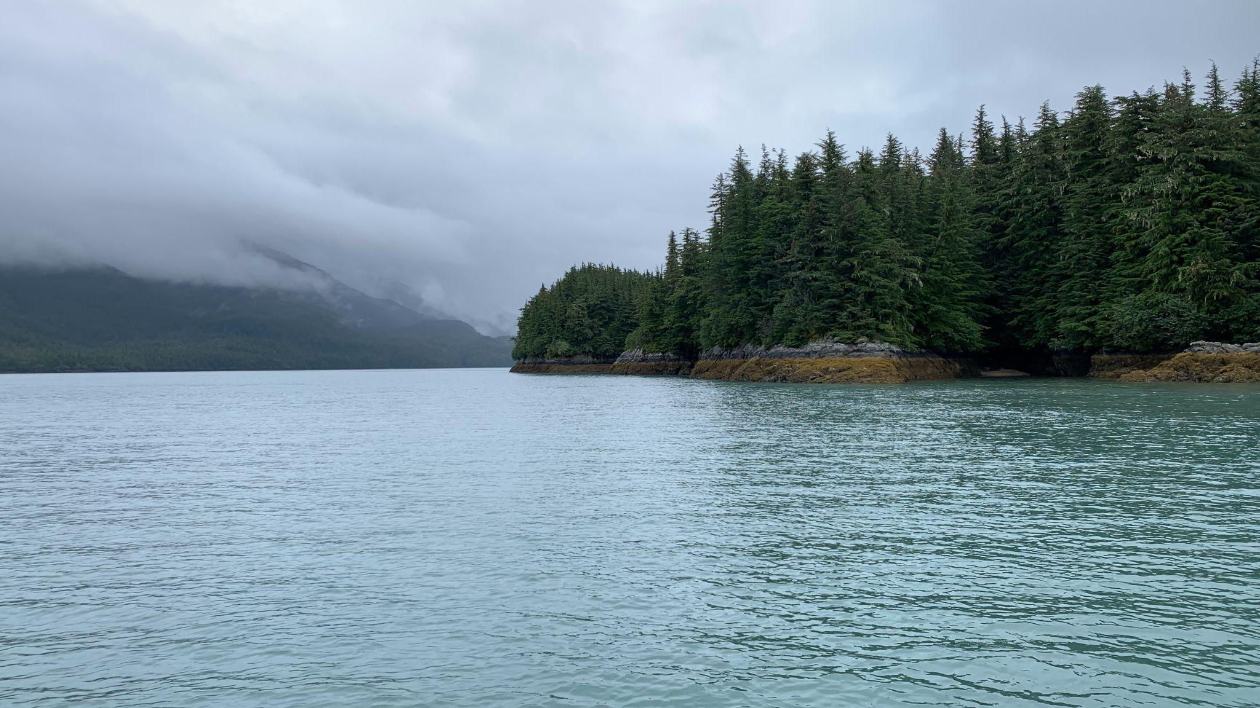
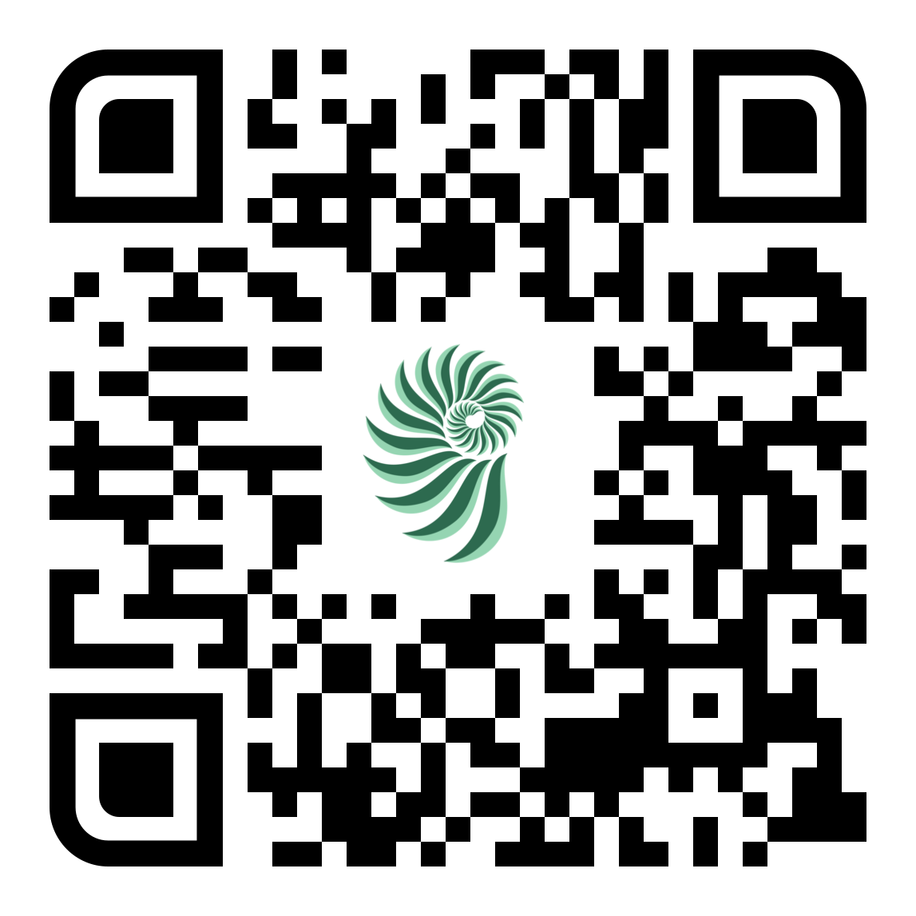
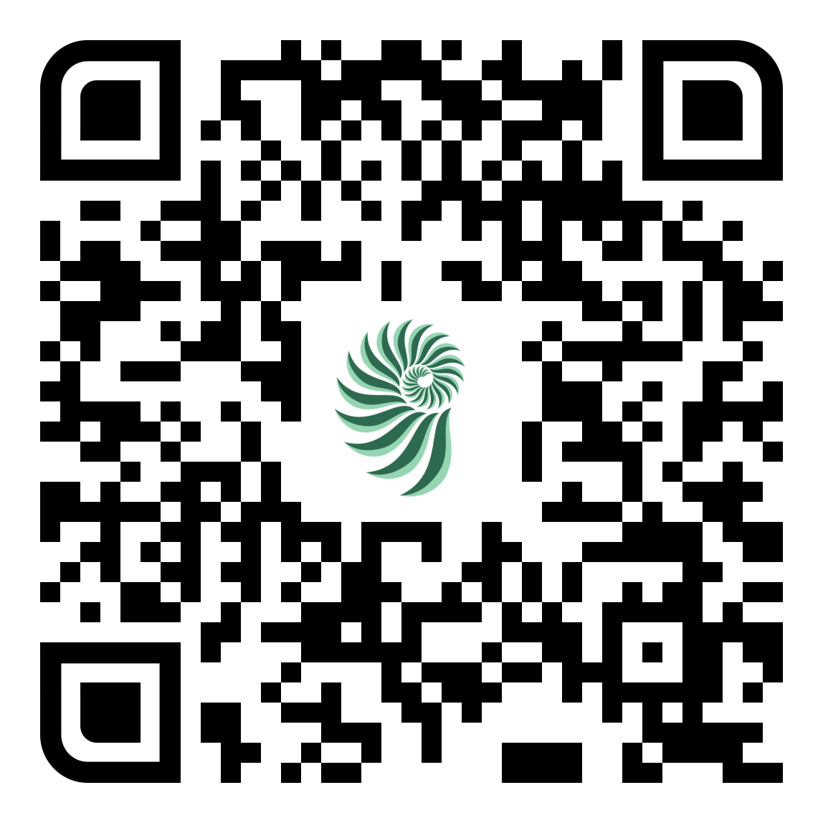
www.greenwave.org
/hub
/seaweed-source
Lindsay Olsen
lindsay@greenwave.org

