Slide 1
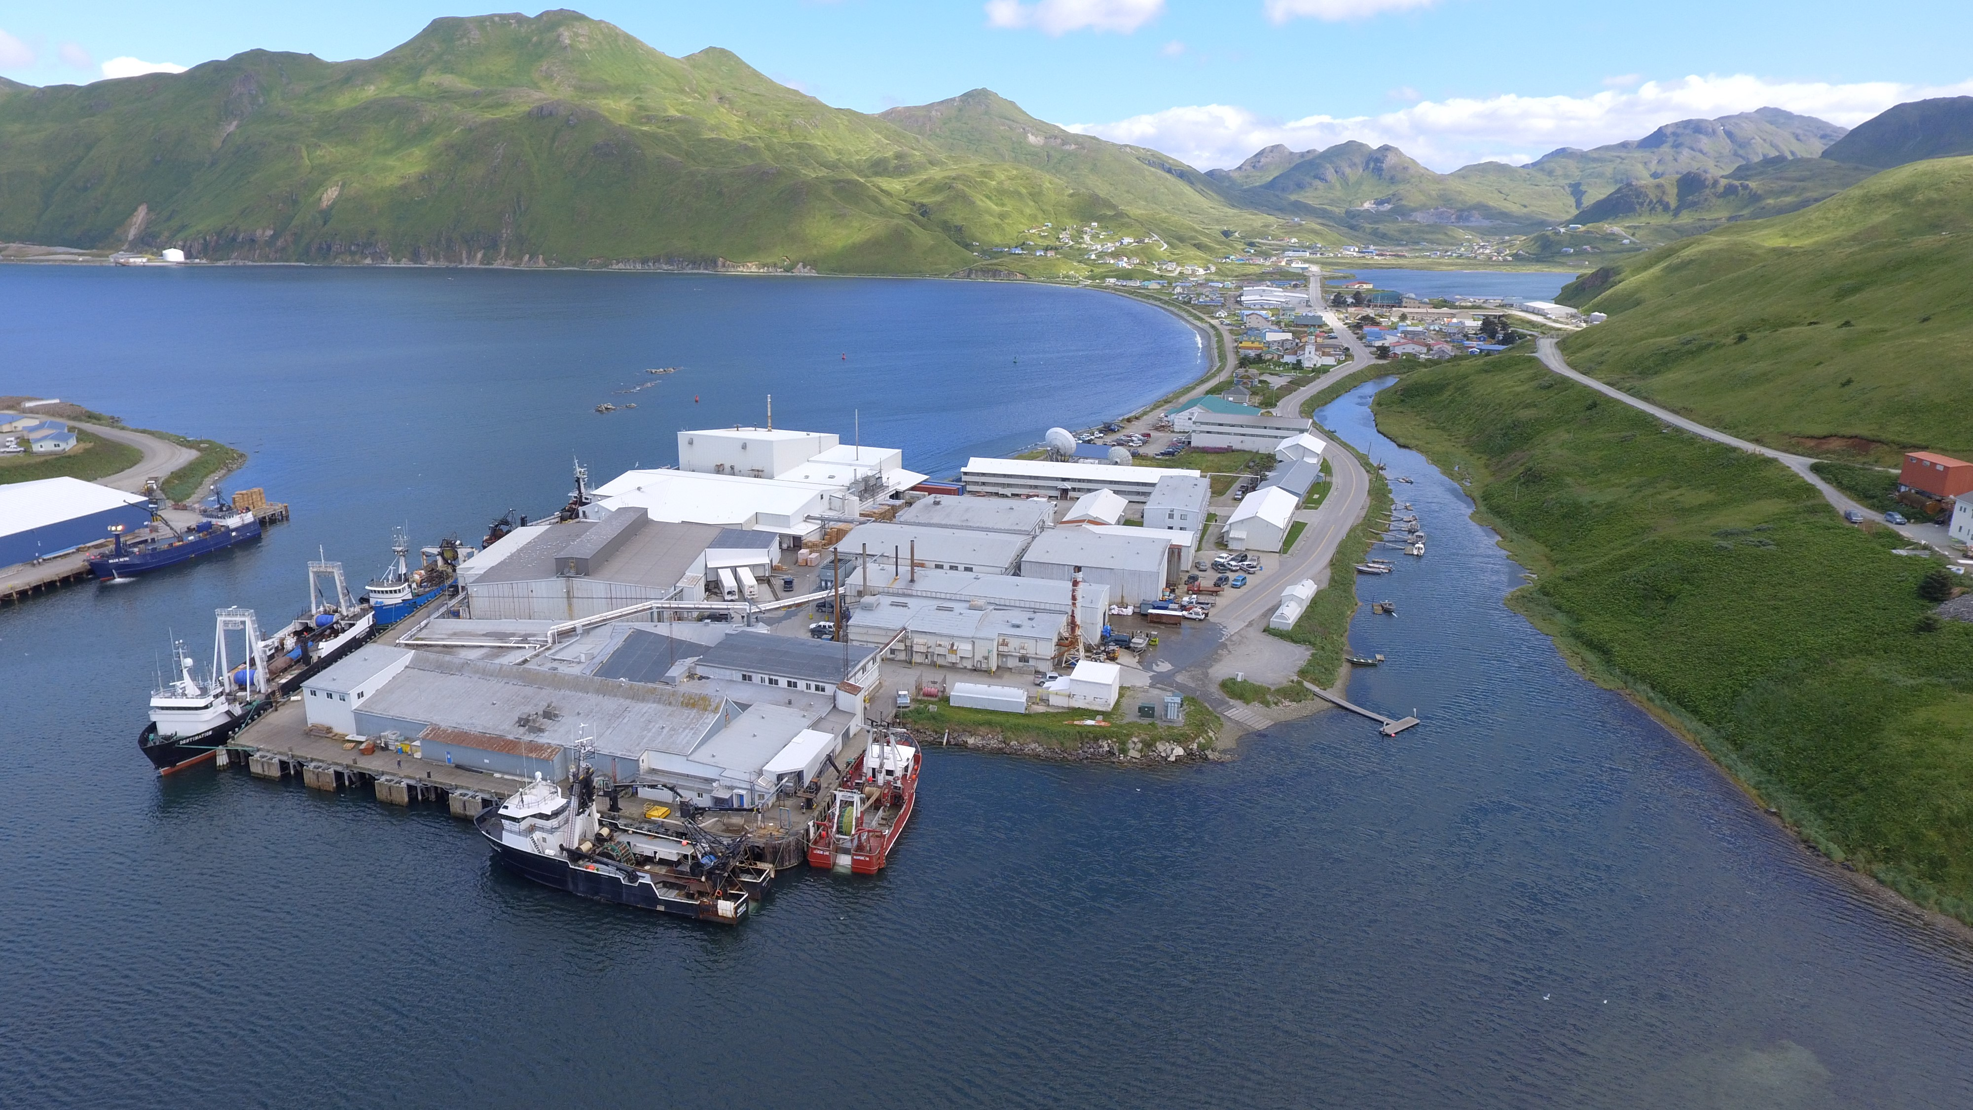
SWAMC 2024 Overcoming Processor Challenges in the Fishing Industry
Nicole Kimball
www.pspafish.net
Unalaska

Slide 2
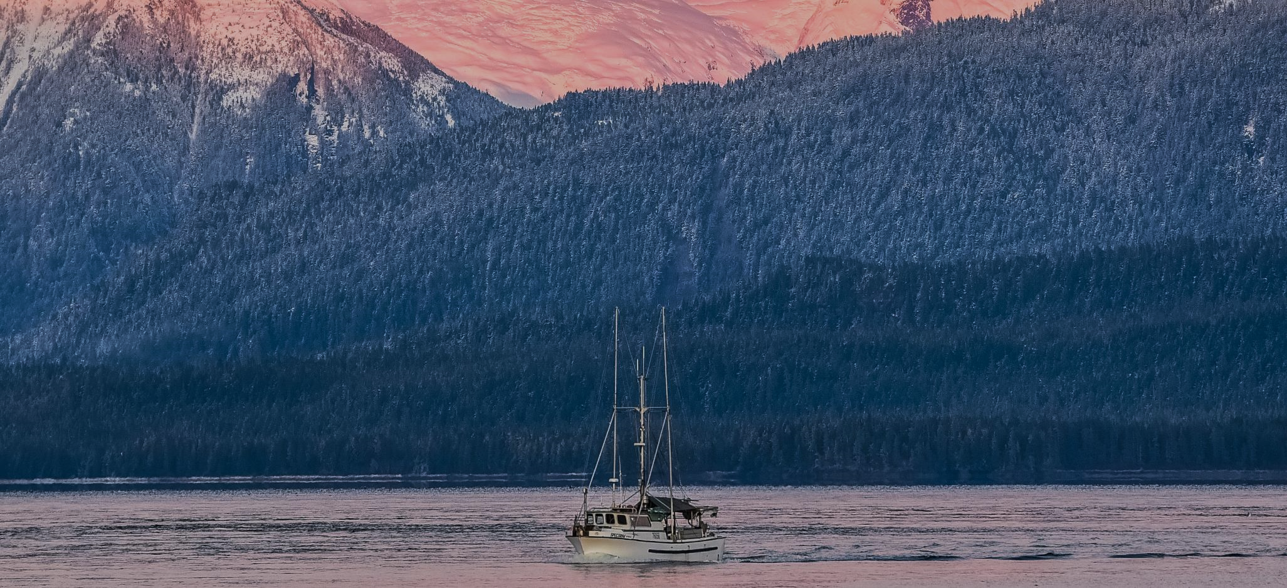
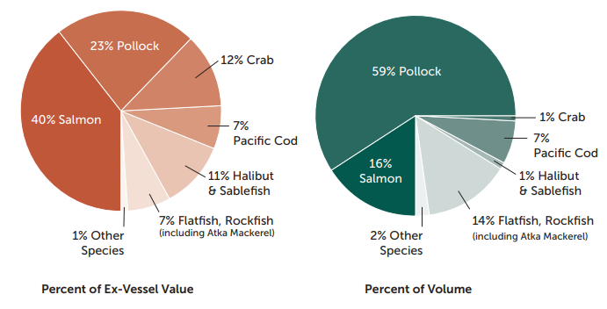
Alaska Seafood (average 2021/2022)
HARVEST VOLUME
5.1 Billion Pounds
EX-VESSEL VALUE
$2.0 Billion Dollars
Pollock & salmon = 75% of volume and 62% of value
Source: NMFS and ADF&G; compiled by McKinley Group 2021/22 data.

Slide 3
Alaska Inshore Seafood Processing
This map shows the location of approximately 85 shoreside facilities in Alaska which process a minimum of 100,000 pounds of seafood annually.
Roughly 10 floating processors operate in multiple locations in a typical year. These floating processors are often supported by shoreside processing infrastructure.
Utqiagvik
Nome
Fairbanks
Anchorage
Juneau
Bristol Bay
Gulf of Alaska
Bering Sea
Shoreside Processor Locations
Floating Processors Area of Operations
Compiled and mapped by McDowell Group.
Note: These data are estimates based on best available data and represent physical plants.
Sources: Alaska Department of Fish & Game; Alaska Department of Environmental Conservation; McDowell Group.
Notes:
This broad level of consistency in landings has helped – annual variability but over time quite consistent – has allowed Alaska to develop an infrastructure and coastal economy around fisheries. Helpful to see the broad distribution of all inshore processing locations in Alaska – this map shows the about 85 facilities that process at least 100,000 lb of seafood annually. There are small, medium and large processors and companies and footprints and all are important. One of the differences in fisheries is the broad impacts across the state as opposed to concentrated benefits in a few communities.

Slide 4
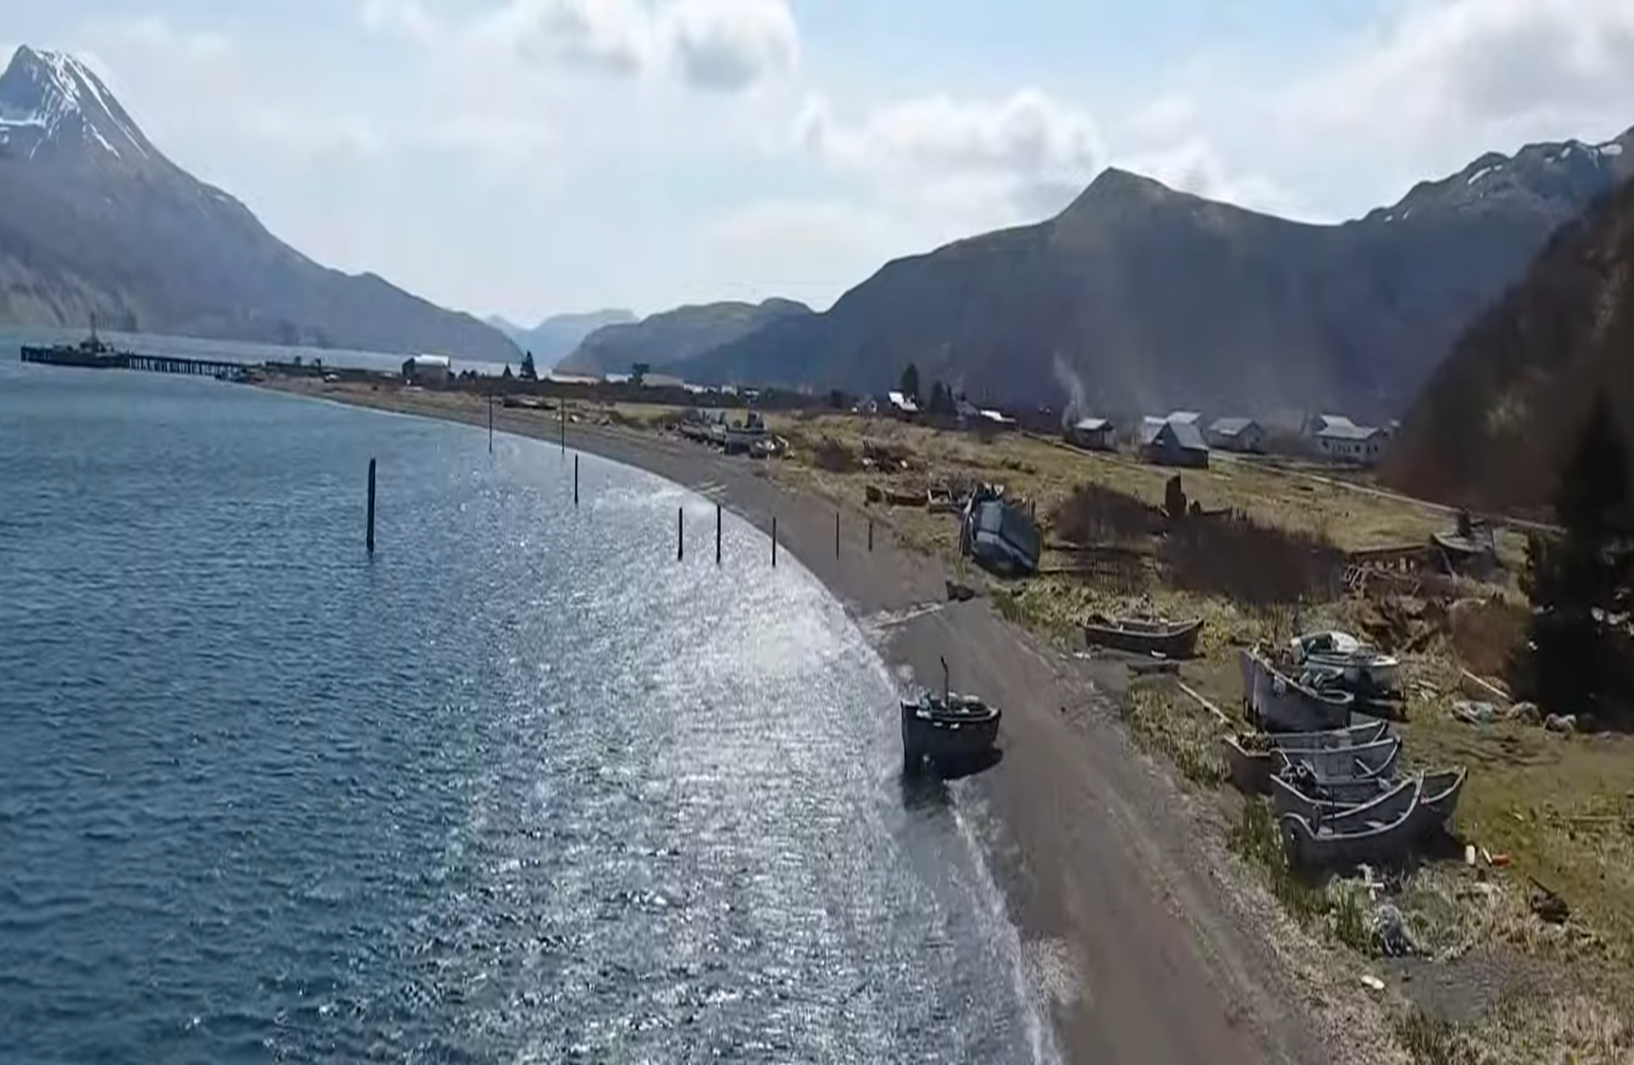
Alaska Seafood – 2021/2022 data
Alaska first wholesale value: $5 billion
Annual economic activity created in AK: $6 billion
Largest private direct employer in the state: 48,000
State and local taxes that sustain communities: $161 million
False Pass. Photo credit AEB
Notes:
With that commercial industry comes these statistics from McKinley group that show the place seafood has in the Alaska economy.

Slide 5
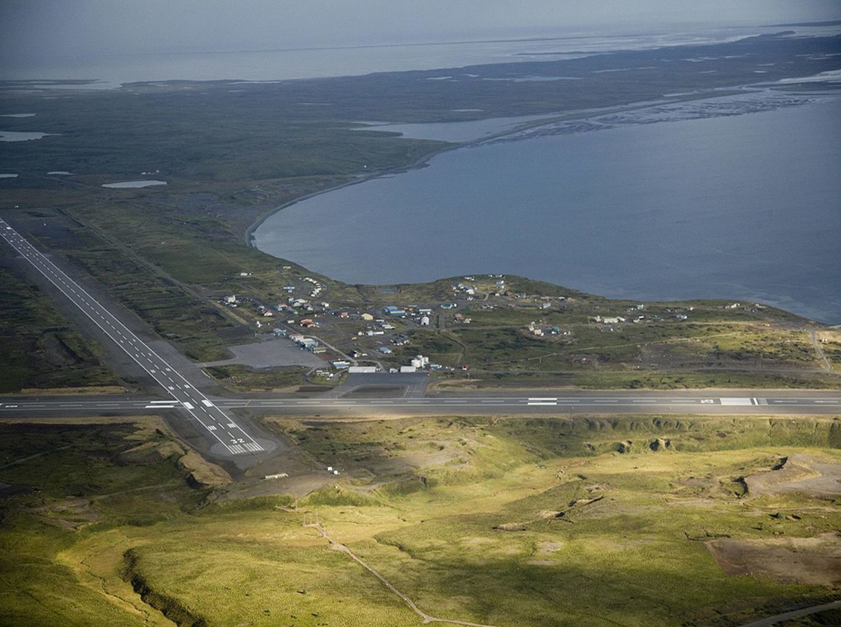
Significant decline in seafood value in 2023
Experts estimate Alaska and its communities lost $2 billion in 2023:
$1 billion in lost first wholesale revenue
$1 billion in decreased spending on vessels, processing, and support facilities
Cold Bay. Photo credit: AEB

Slide 6
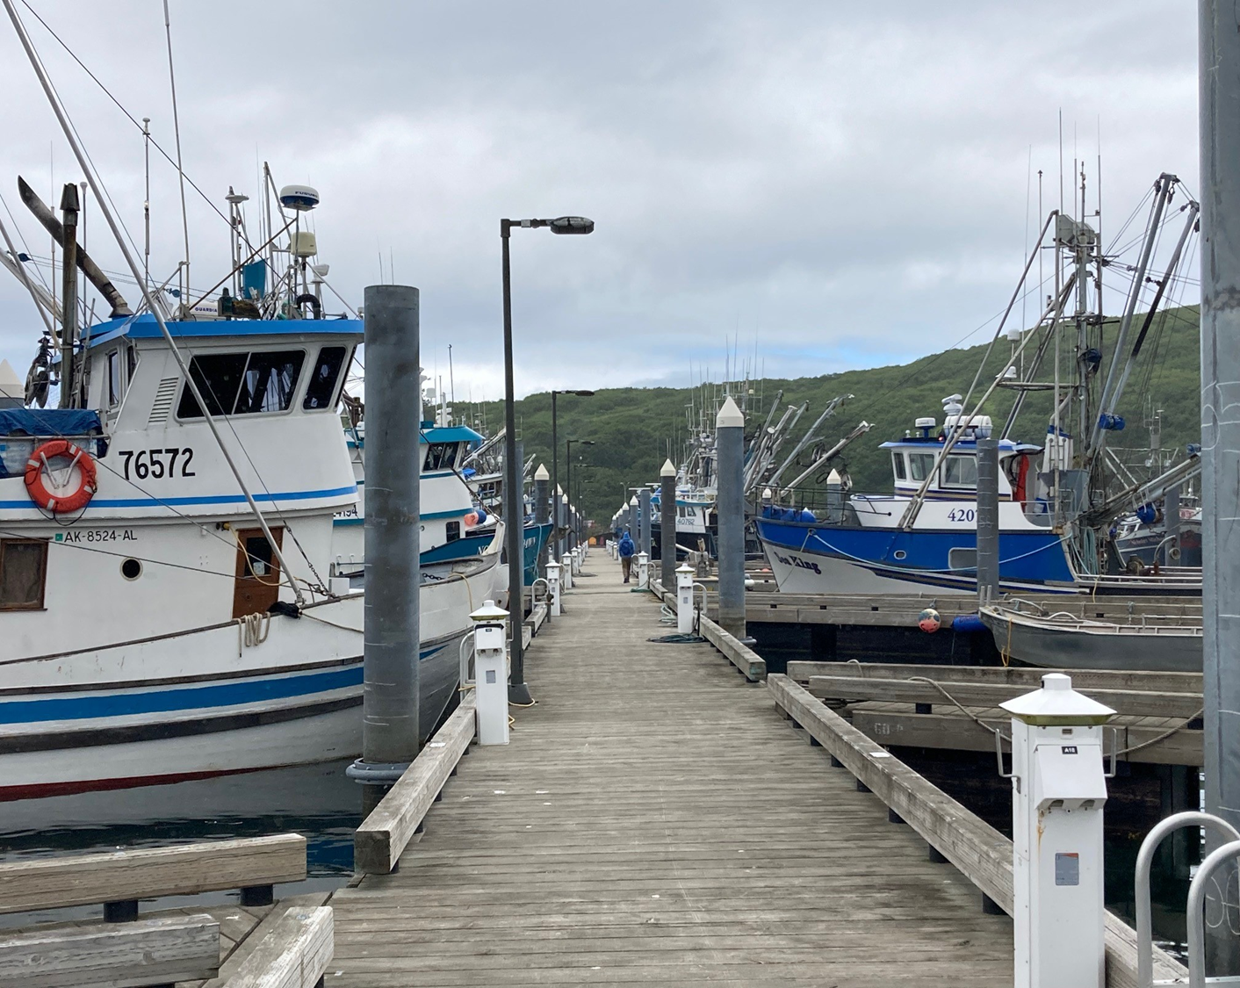
Significant decline in seafood value in 2023
Affected almost all AK fisheries and regions
Lower prices paid to fishermen
Lower prices paid to processors
Processors ended season early in some cases as sales stagnated
Excess inventory (2022) held in cold storage in the seafood supply chain (processors, wholesalers, retailers)
Sales prices lowered to move product for cash in 2023
Communities’ fish tax revenues significantly affected
Sand Point. Photo credit: AEB

Slide 7
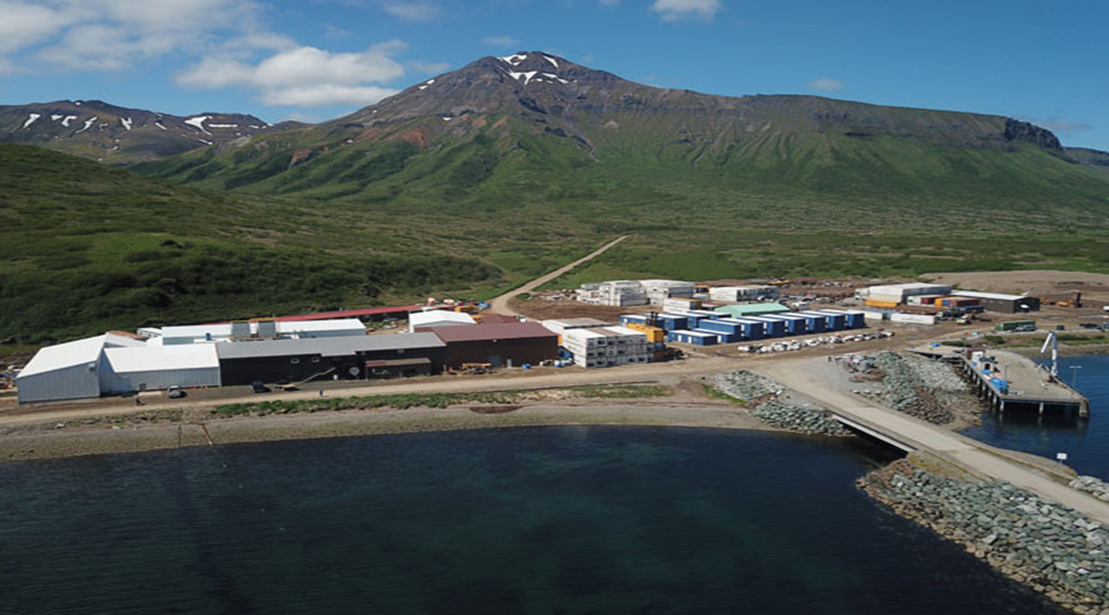
Overall factors affecting seafood value in 2023
Russia dumping fish in global markets to fund war
Excess global inventory
Inflation affecting consumer demand
Strong US dollar making AK fish more costly in export markets
Increased costs of harvesting and processing operations compared to other countries
Value may start to normalize in 2024, but production costs remain a serious challenge for the industry
False Pass. Photo credit: AEB

Slide 8
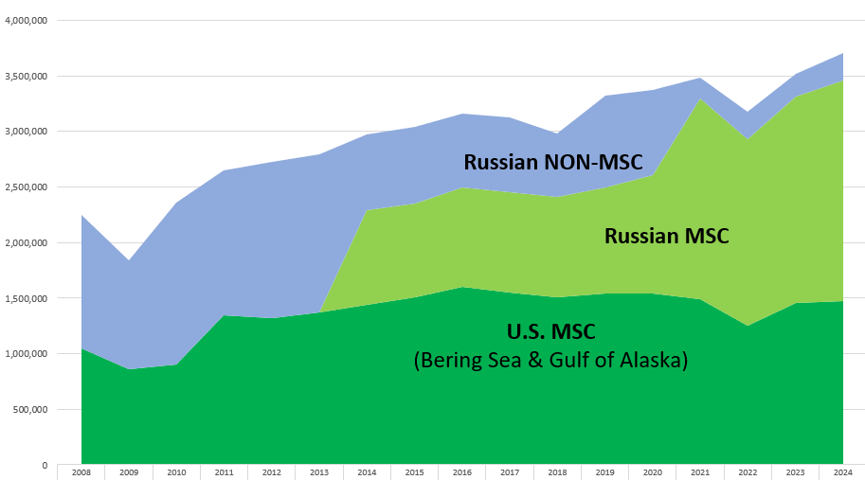
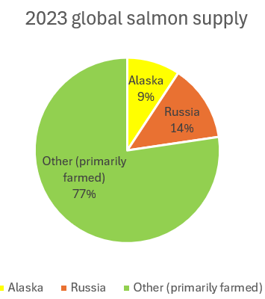
Factors affecting seafood value in 2023: Russia
Pollock TAC
Notes:
What's important here is not just increased production:
Russia harvests same species as AK
Russia dumping fish in global markets to fund war
Russia govt subsidized building of new vessels and processors (offshore and onshore) and increased their production – created a price war with express intent to take market share from US processors. They now compete in markets that were previously off limits to them, either because of quality or lack of product diversification
Explicit about being able to surive a price war (Undercurrent News, Nov 7, 2023). They know it costs more to operate in the US, to build vessels in the US, to employ a workforce in the US
So Russia putting product on the market at lower prices than it costs us to produce a similar product (in key markets) undermines AK ability to compete

Slide 9
What can we do to stabilize seafood industry?
Develop & diversify emerging markets and strengthen existing markets (ASMI)
Increase consumer demand in US markets, particularly important given ban on Russian seafood imports (ASMI)
Support federal trade policies that are inclusive and fair to the US seafood industry
Increase & expand USDA support for US seafood including food purchase programs, loan programs, national marketing, and other federal ag programs

Slide 10
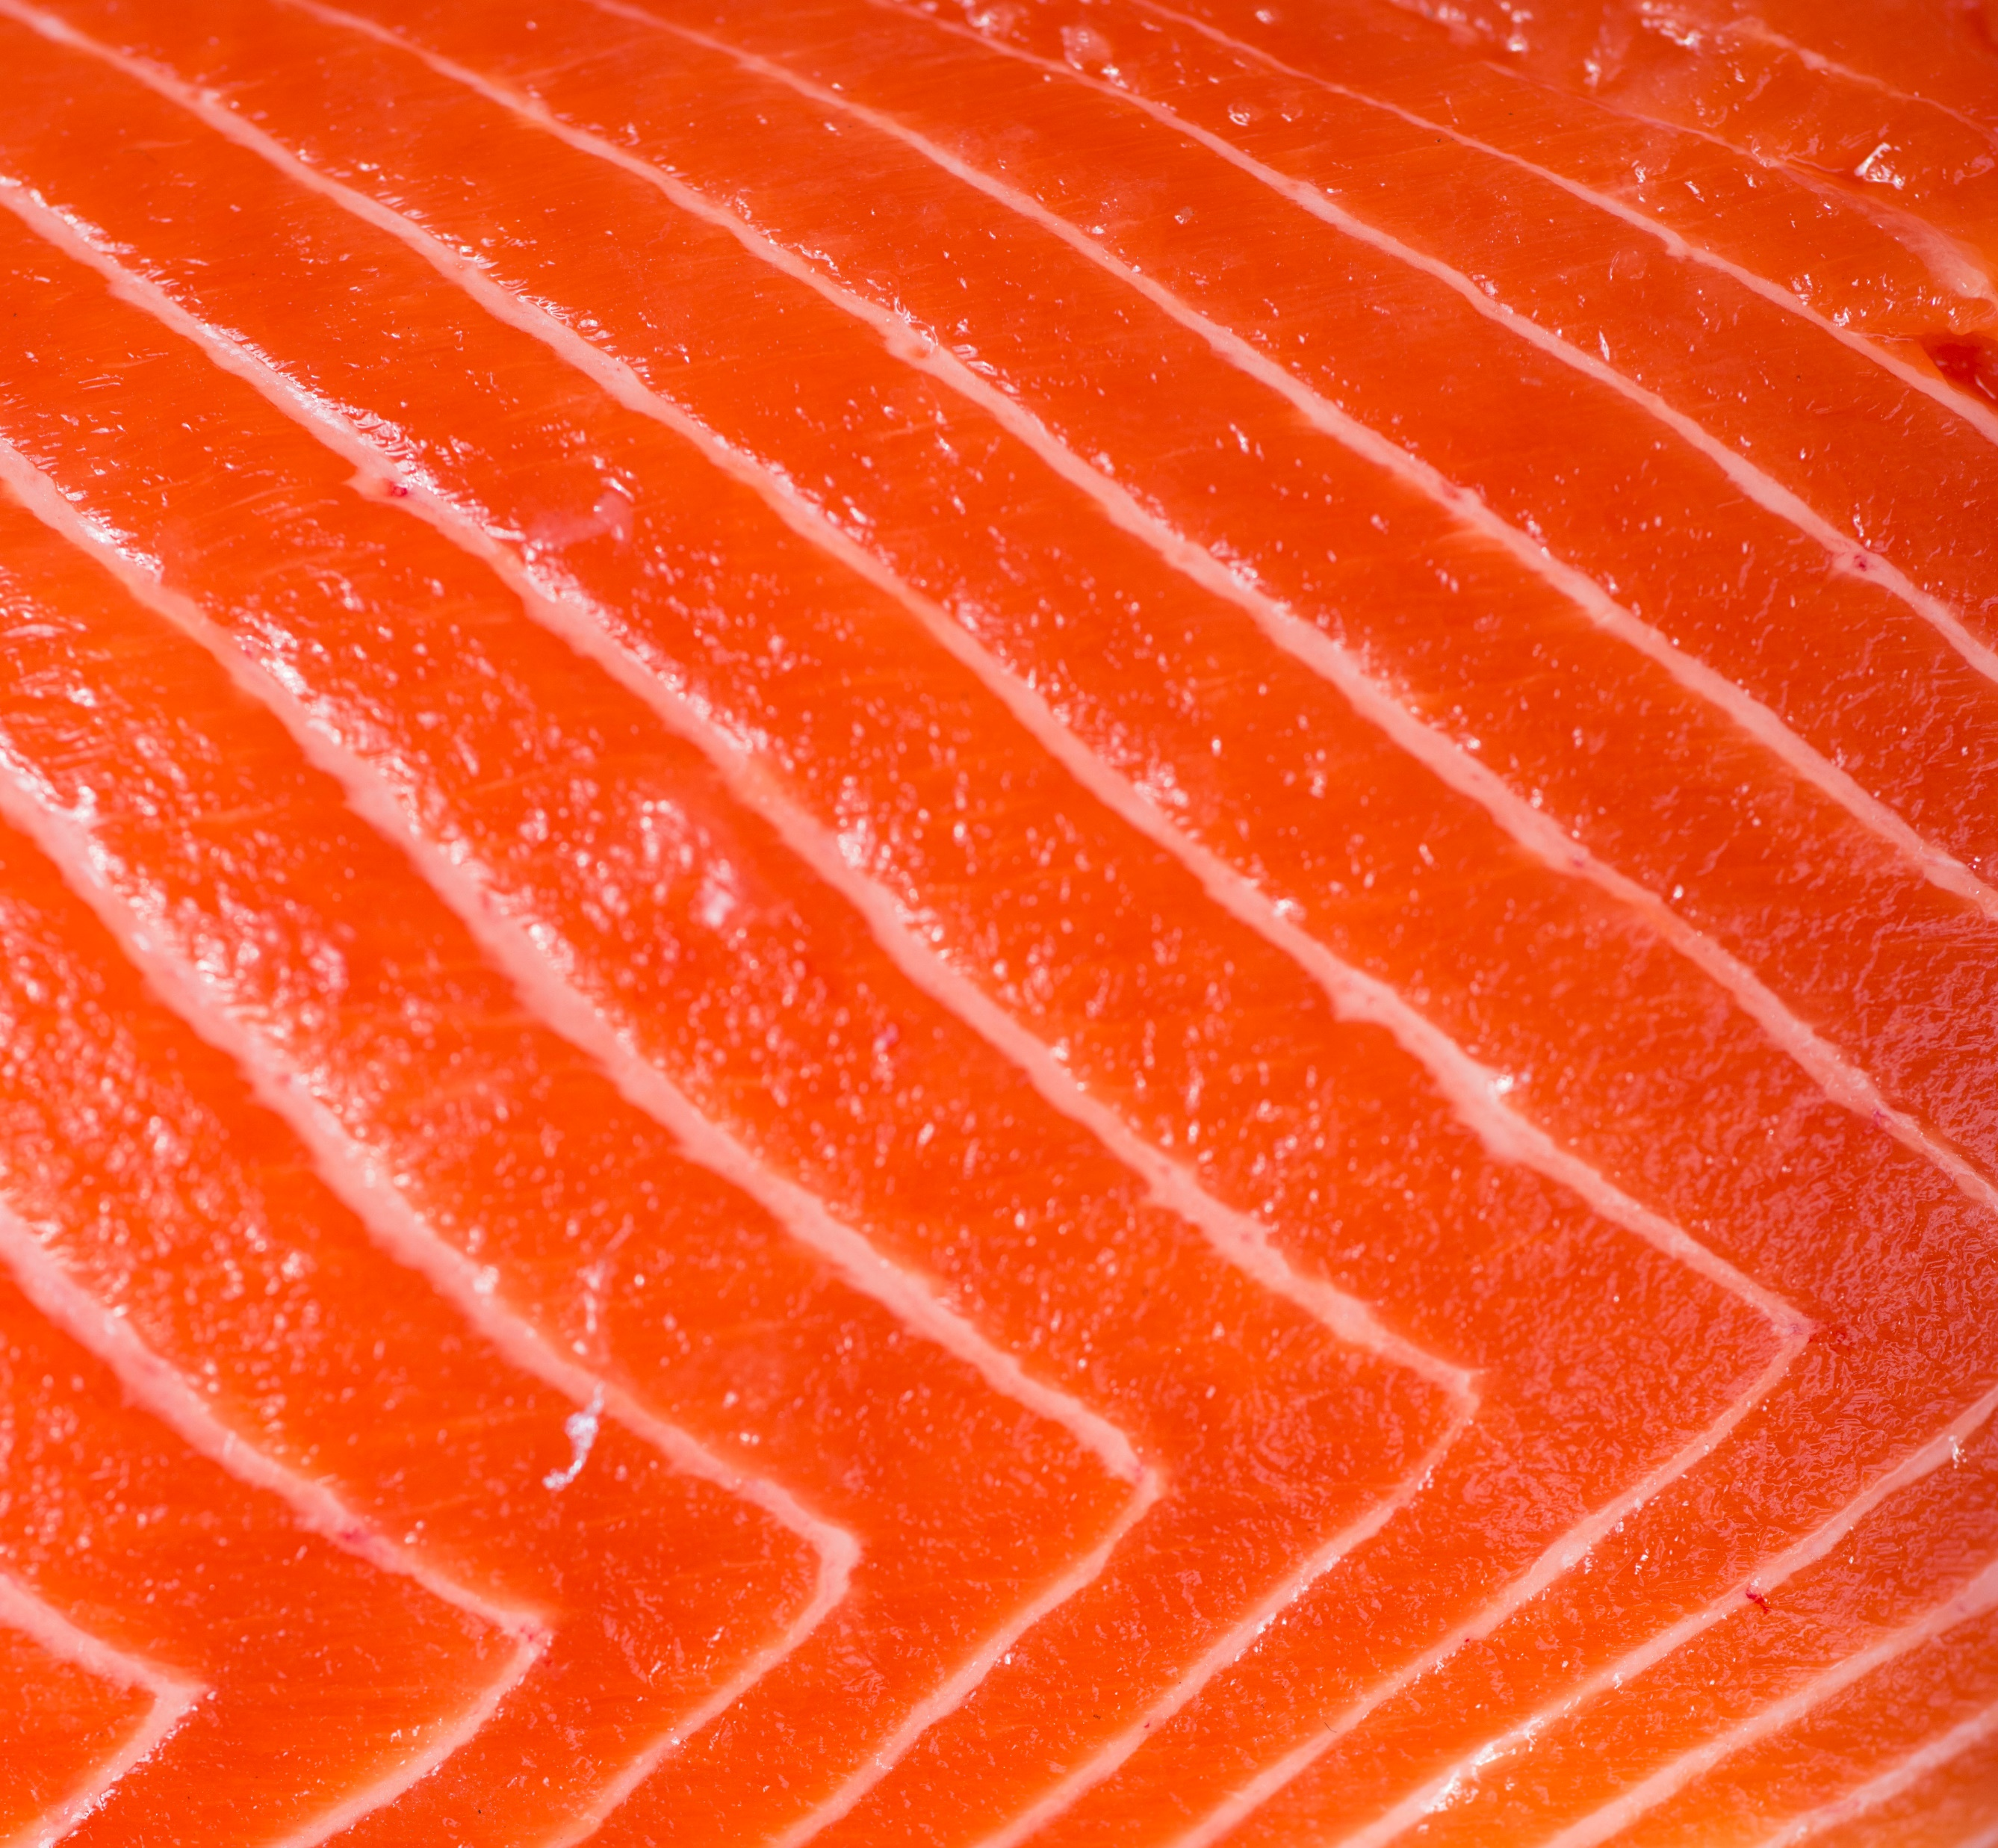
What can we do to stabilize seafood industry? State actions needed now
Support federal actions needed at USDA & USTR
Provide loan guarantees and low interest loans to seafood processors
Defer loan and interest payments and extend terms for fisheries enhancement and fishermen (existing revolving loan funds)
Provide state funding to ASMI ($10 million) to fill budget gap due to low seafood value and to seize domestic market opportunity due to Russian seafood prohibition

Slide 11
What can we do to stabilize seafood industry? State actions
Expand seafood product development tax credit to include automation and renewable energy conversion
Implement recommendation from the state’s 2023 Alaska Workforce Convening (report at end of March)
Integrate seafood into Alaska Office of Food Security
Support science based decision-making and a stable regulatory environment (BOF & NPFMC)

Slide 12
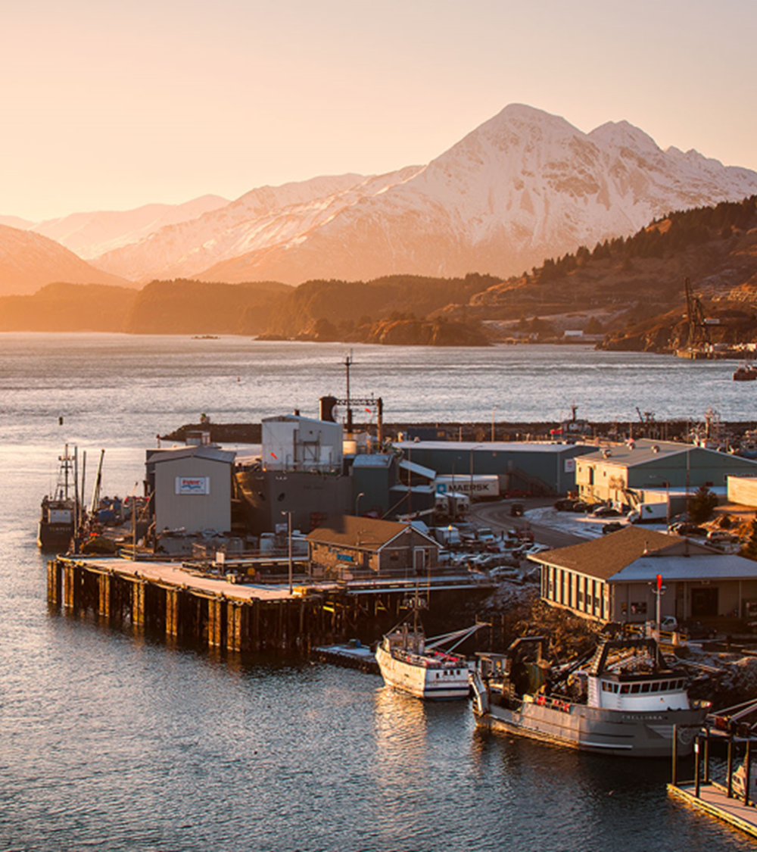
Community engagement Letters or resolutions in support of Federal govt actions
Aleutians East Borough
Bristol Bay Borough
City of Dillingham
Haines Borough
City of St. Paul
Central Bering Sea Fishermen’s Assn
City of Kodiak
City of Pelican
City and Borough of Petersburg
City and Borough of Wrangell
City of Ketchikan
Ketchikan Gateway Borough
Southeast Conference
United Fishermen of Alaska (UFA)
Resource Development Council
Kodiak

Slide 13
Legislative engagement
Potential access to state low interest loans and loan guarantees
Potential expansion of existing seafood value added tax credits
ASMI budget
Senate Joint Resolution 14: Calling on US Congress and federal agencies to adopt policies and engage in efforts to improve the competitiveness and resiliency of AK seafood industry
Senate Concurrent Resolution 10: establishing a Joint Legislative Seafood Industry Taskforce to address economic challenges
Naknek, AGS
Notes:
Senate sponsors: Senators Bishop, Bjorkman, Claman, Hoffman, Giessel, Stevens, Dunbar, Merrick, Kiehl, Tobin, Shower, Wilson, Gray-Jackson, Olson, Hughes, Kaufman, Stedman, Wielechowski, and Kawasaki
House sponsors: Representatives Ortiz, Armstrong, and Hannan

Slide 14
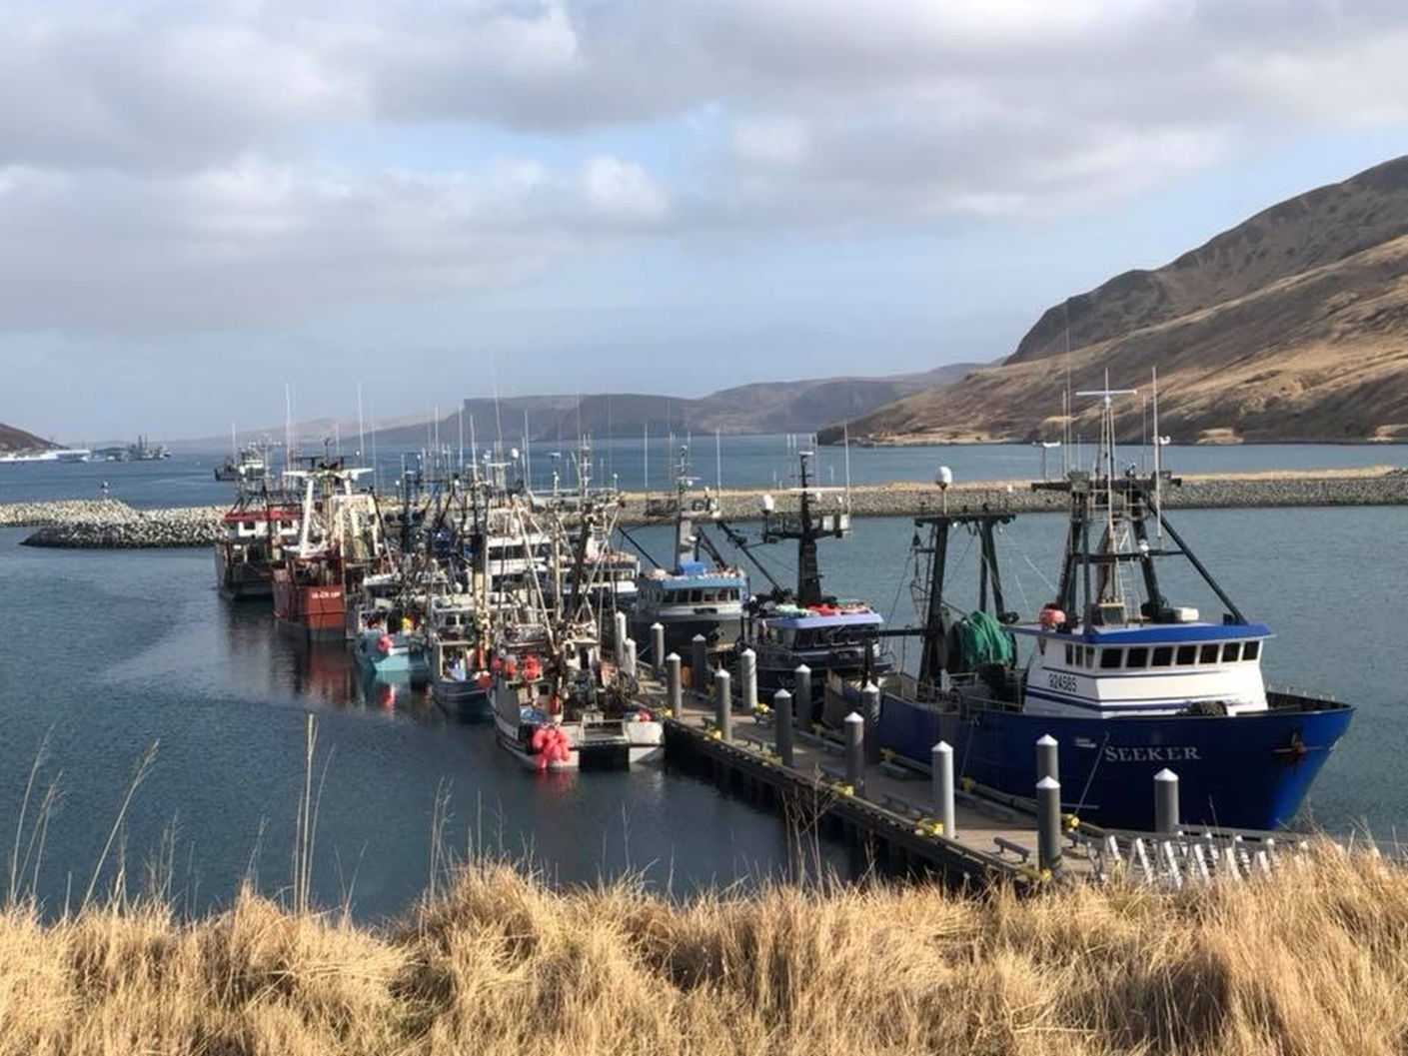
Thank you!
https://www.pspafish.net/pspa-positions
Akutan, AEB.

