Slide 1
Developing Alaska’s Healthcare Workforce
Presenter: Lynda Hernandez, MS

Slide 2
What the heck is AHEC?
Our Mission
We are a federally-supported program that supports the development of the healthcare workforce.
Enhance access to quality health care, particularly primary and preventive care, by improving the supply and distribution of healthcare professionals through community/academic educational partnerships.
Notes:
AHEC stands for Area Health Education Center (AHEC).

Slide 3
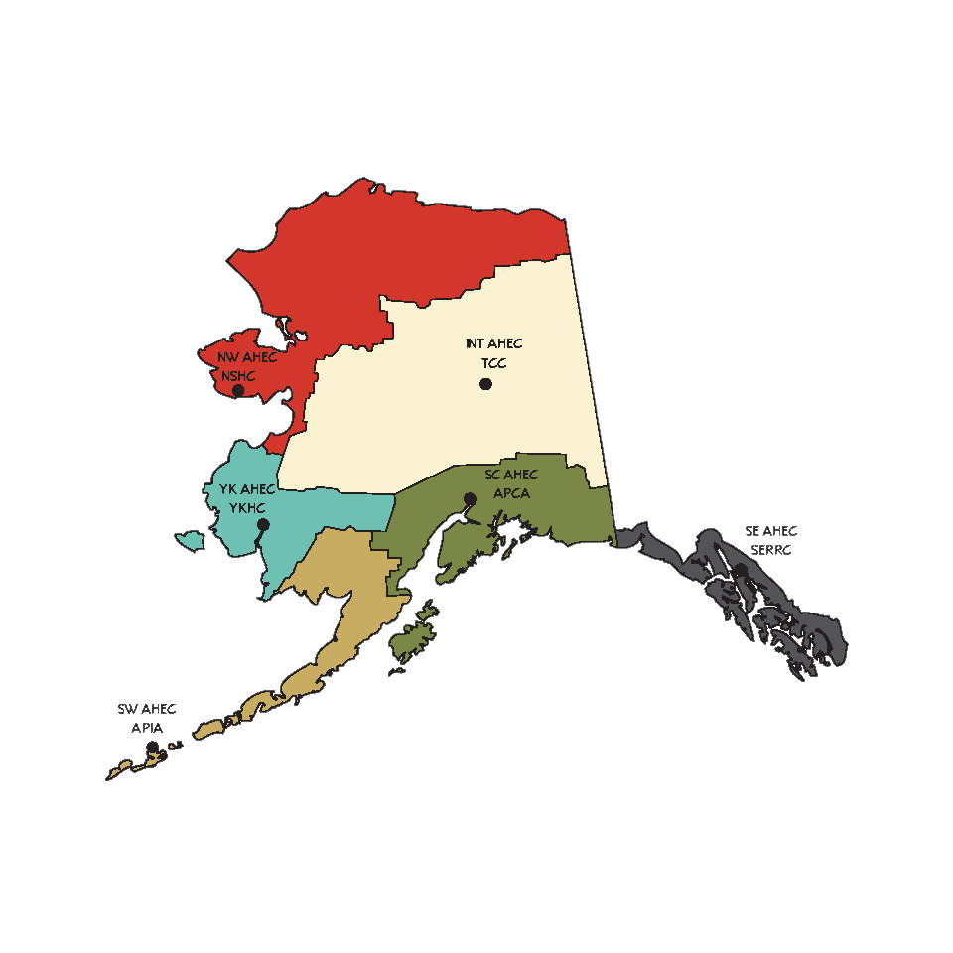
The Alaska AHEC Program
Southwest AHEC
Northwest AHEC
Yukon Kuskokwim AHEC
Interior AHEC
Southcentral AHEC
Southeast AHEC

Slide 4
ACRH-HW and AHEC Programs
Engage
Train
Retain
Youth Exploration Camps
Rural Health CTEPS Program
PATH Academy
Rural Alaska Institute of the North (RIIN)
AHEC Scholars Program
Certificate Trainings
Strengthening Healthcare Access Recruitment Program (SHARP)
Clearinghouse of Alaska's Continuing Health Education (CACHE)

Slide 5
Diversity: Preparing a diverse, culturally competent primary care workforce representative of the communities we serve.
Distribution: Improving workforce distribution throughout the nation, particularly among rural and underserved areas and populations.
Practice Transformation: Developing and maintaining a healthcare workforce that is prepared to deliver high quality care in a transforming health care delivery system with an emphasis on rural and underserved communities.

Slide 6
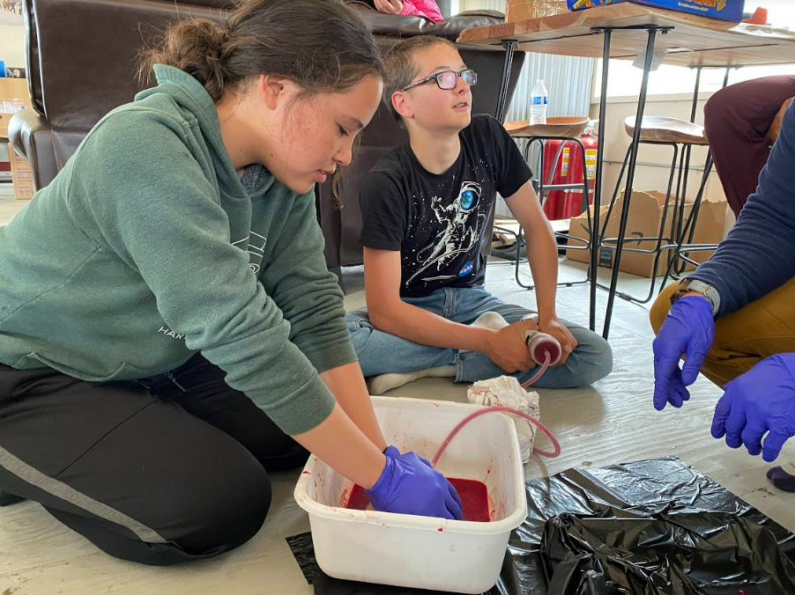
Youth Programming
Middle School
Curriculum tailored specifically for middle school aged students. Content covers allied health & behavioral health career exploration
Certificate Training:
CPR
First Aid
Bloodborne Pathogen
High School
Youth Camps and In School Intensives for Allied Health & Behavioral Health Career Exploration
Certificate Training:
Teen Mental Health First Aid
CPR/Basic Life Support
First Aid
Bloodborne Pathogen
“I thought this was a really good experience with balanced learning and activities to keep us interested. It gave me good general knowledge and I learned how I could expand my knowledge in specific areas.”
-Youth Programming Participant
Youth Mental Health First Aid is a popular training for teachers and schools.
Notes:
Several rural health care career camps going on in NW between Nome Kotzebue and Utqiagvik.

Slide 7
Certificates and Trainings
Mental Health First Aid -- Youth, Teen, and Adult
CPR/Basic Life Support
First Aid
Bloodborne Pathogen Training
Mandt De escalation Training
Stop the Bleed
Promoting Community Conversations About Research to End Suicide (PC CARES)

Slide 8
PATH Academies Statewide Entry-Level Position or Apprenticeship
Created by the South Central Alaska AHEC (SC AHEC) in 2017. Designed to take anyone interested in healthcare and transform them into excellent candidates for apprenticeship and entry level jobs.
Expanded statewide in 2023
Free two-week pre-apprenticeship training
Open to adults 16 years old and older
No prerequisites necessary
Explore careers in healthcare, behavioral health, and human services
Acquire job readiness skills and certifications
Job fair and one-on-one case management
Content includes: HIPAA, Documentation, Medical Terminology, Mandatory Reporting, Body Systems, ACEs, Social Determinants of Health
Notes:
Elevator pitch: Pre-apprenticeship training in healthcare. Designed to take anyone who is interested or thinks they might be interested from not knowing anything to being an excellent candidate for a pre-apprenticeship job. Good for people who know about healthcare and need to update their skills. Goal is to have them job ready at the end of 3 weeks of training. (can make exceptions to the 18 yo; don’t have to be a highschool graduate). Must be in Alaska.
Selling points are certifications (couple hundred dollars), background check ($120), and drug screening – financial blessing
Job fair at the end of the three weeks – hospitals, clinics, lab techs, private long term care facilities, front office staff
Work one-on-one students with a job, apprenticeship, or further training (connect them to resources to help pay for EMT or UAA nursing)
Happen every month (held in person with a virtual option) – 3 days required in person for certification BLS/FA, MHFA, MANDT (de-escalation training) – If cannot attend in person they just will not receive those certifications; if in bethel or Nome we do our best to connect them to places where they can get their certifications
9am-3pm M-F for 3 wks (90hrs); some homework
State Government Funds (3 different sources) – Good jobs challenge (expand to rural Alaska)
Report to the state of Alaska once per year and the state does long term tracking on them
Employers who have hired path academy students now have it as a preferred requirement on applications
Topics covered:
HIPAA
Documentation
Mandatory Reporting
Medical Terminology
Body Systems
Adverse Childhood Experiences (ACEs)
Social Determinants of Health (SDOH)

Slide 9
Rural Health CTEPS Program
In person, flexible courses for college credit - curriculum aligned with NCHSE standards
Fundable through Perkins V
Target Audience: 11th and 12th grade students
Students are eligible for high school and college credits
Courses:
Health 110 – Health Care Occupations (distance delivered)
Health 120 – Human Services Occupations (distance delivered)
Health 130 – Professionalism in Health Care (capstone at UAA)
Health 150 – Health and Human Services Employment Certifications (capstone at UAA)
Scan to learn more about our CTEPS Program

Slide 10
Post-Secondary Connections AHEC Scholars
Provide students community based experiential learning in rural and underserved communities.
Support community events
Shadowing, networking, and facility tours
Provide professional development, cultural competency, and industry recognized certification trainings
Scan to learn more about the AHEC Scholars Program

Slide 11
Contact us for more Information!
Call or Email
Lynda Hernandez
Associate Director Alaska Center for Rural Health and Health Workforce
Phone: 907-786-6591
Email: lrhernandez@alaska.edu
Visit our Website: https://www.uaa.alaska.edu/acrhhw
Follow us on Social Media: https://www.facebook.com/AlaskaAHEC/
Notes:
Lynda Hernandez
Associate Director, Alaska Center for Rural Health and Health Workforce
907-786-6591
lrhernandez@alaska.edu
Alaska AHEC Website
https://www.uaa.alaska.edu/academics/college-of-health/departments/acrhhw/
https://www.uaa.alaska.edu/acrhhw
Anchorage PATH Academy Website and Application
https://alaskapca.org/healthcare-pre-employment-training-path/
Secondary education programming interest form
https://docs.google.com/forms/d/e/1FAIpQLScR8RillnaHRHEZzGGrsD8MqrXI5xeFJ372n6BBZLhMb45rhg/viewform?usp=sf_link

