Slide 1
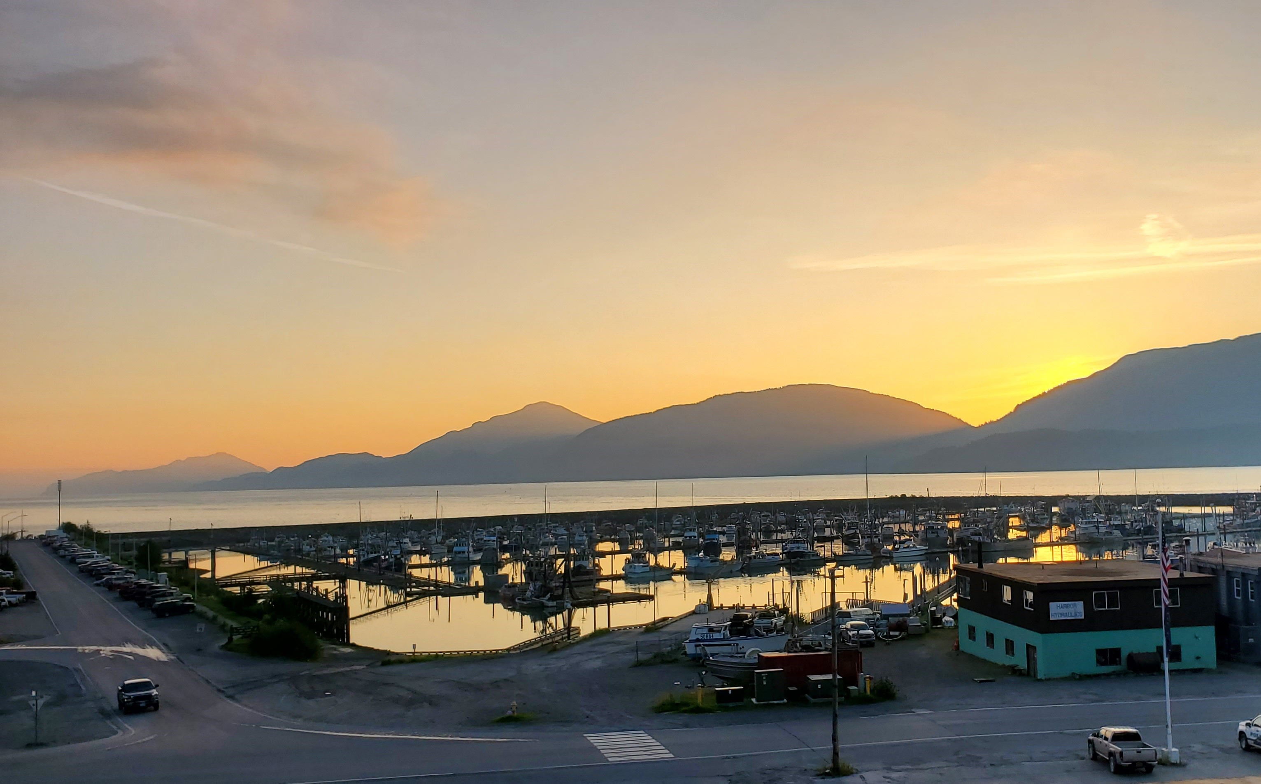
SWAMC Meeting
March 6, 2024
Southeast
Conference

Slide 2
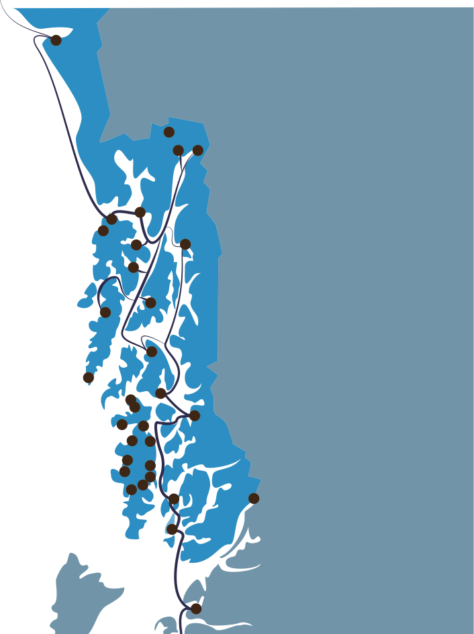
ABOUT SOUTHEAST CONFERENCE
Southeast Conference was incorporated in 1958, primarily to advocate for the creation of the Alaska Marine Highway System.
After that success, stayed together to continue to advocate for issues that are key to the southeast region as a whole.
Looks for consensus for the betterment of the region and State through partnerships and cooperative agreements.
Members from nearly every community, chamber of commerce, and economic development organization in the region.
Conduct economic planning through CEDS process and implement CEDS, providing technical assistance and project development support.
Southeast Conference is the federally designated Regional Economic Development District and the State-designated Alaska Regional Development Organization.

Slide 3
2025 SOUTHEAST ALASKA ECONOMIC PLAN
Recipient of the 2021 NADO Impact Award
2021
Notes:
Award for creative approaches to advancing community and economic development and improved quality of life while making significant impacts on their regions and demonstrate the diversity of services and program delivery provided.

Slide 4
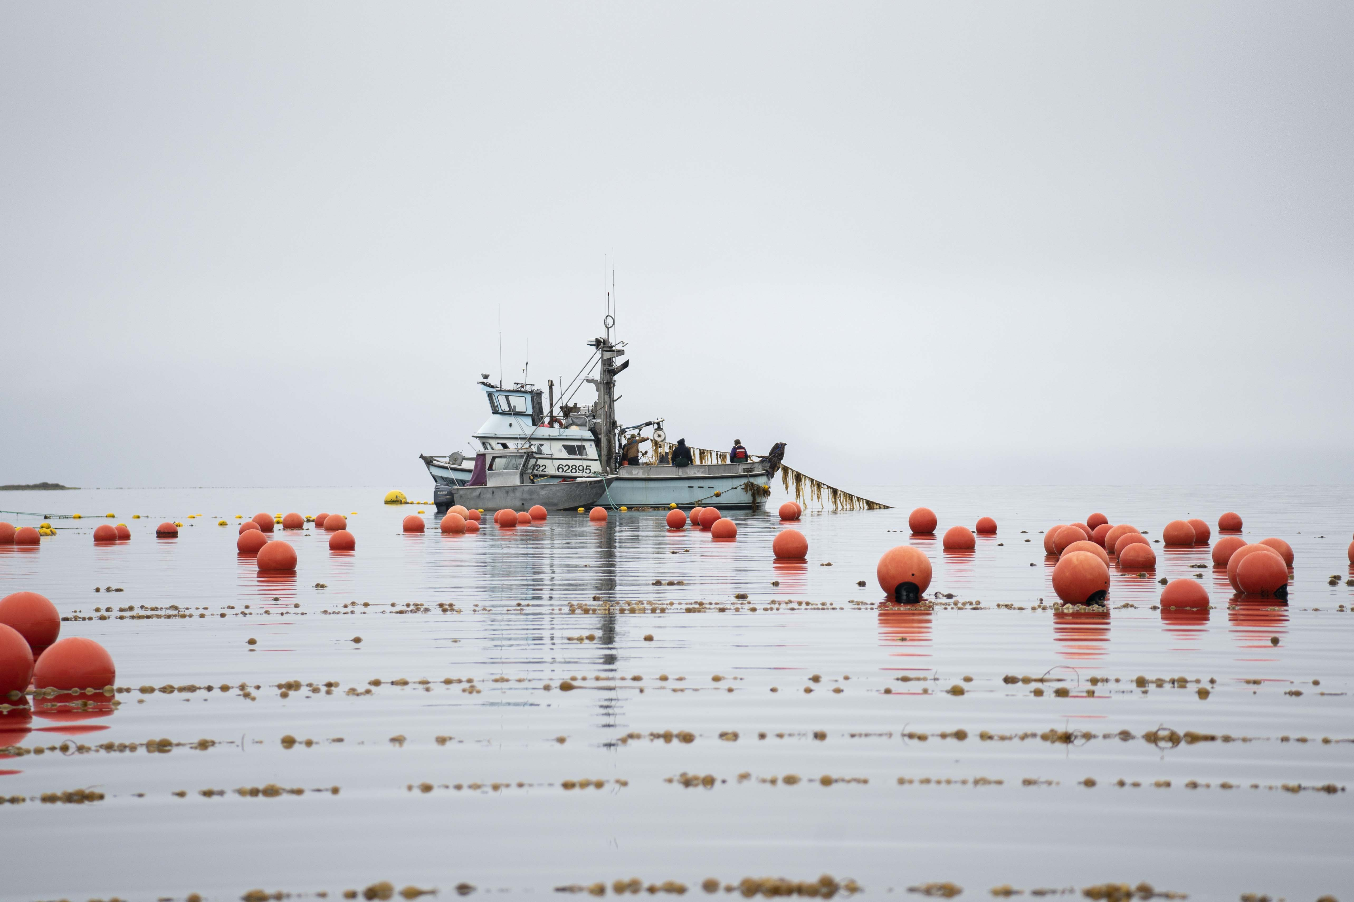
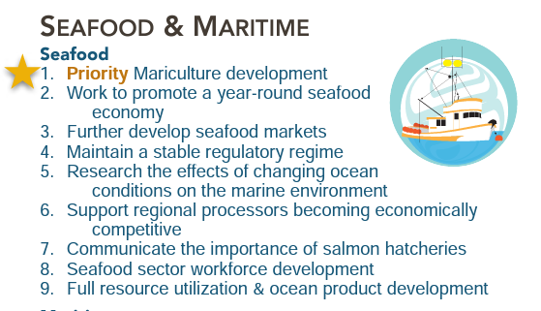
Mariculture = Opportunities & Benefits for Alaskans economic, environmental, community, cultural, and food security
Why mariculture?
Seagrove Kelp Company harvesting near Craig, Alaska
Notes:
One of four priorities identified. Others: AMHS advocacy, tourism marketing, and beneficial electrification.

Slide 5
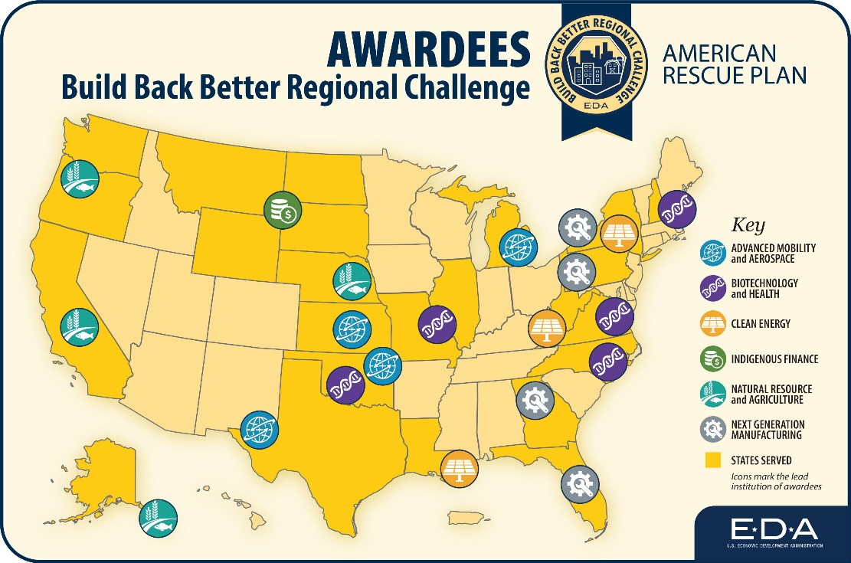
529 -> 60 -> 21
Mariculture Revolving Loan Fund
Governance, Coordination & Outreach
Workforce Development
Research and Development
Market Development
Green Energy
Equipment and Technology
Notes:
The Alaska Mariculture Cluster Coalition is 1 of 21 Build Back Better Regional Challenge (BBBRC) Phase 2 awardees selected from a pool of 60 finalists and 529 applications from across the United States and its territories. The 21 projects aim to create good-paying jobs, catalyze emerging industries, and prepare our workforce for the future bold investments needed into our nation’s local economies.

Slide 6
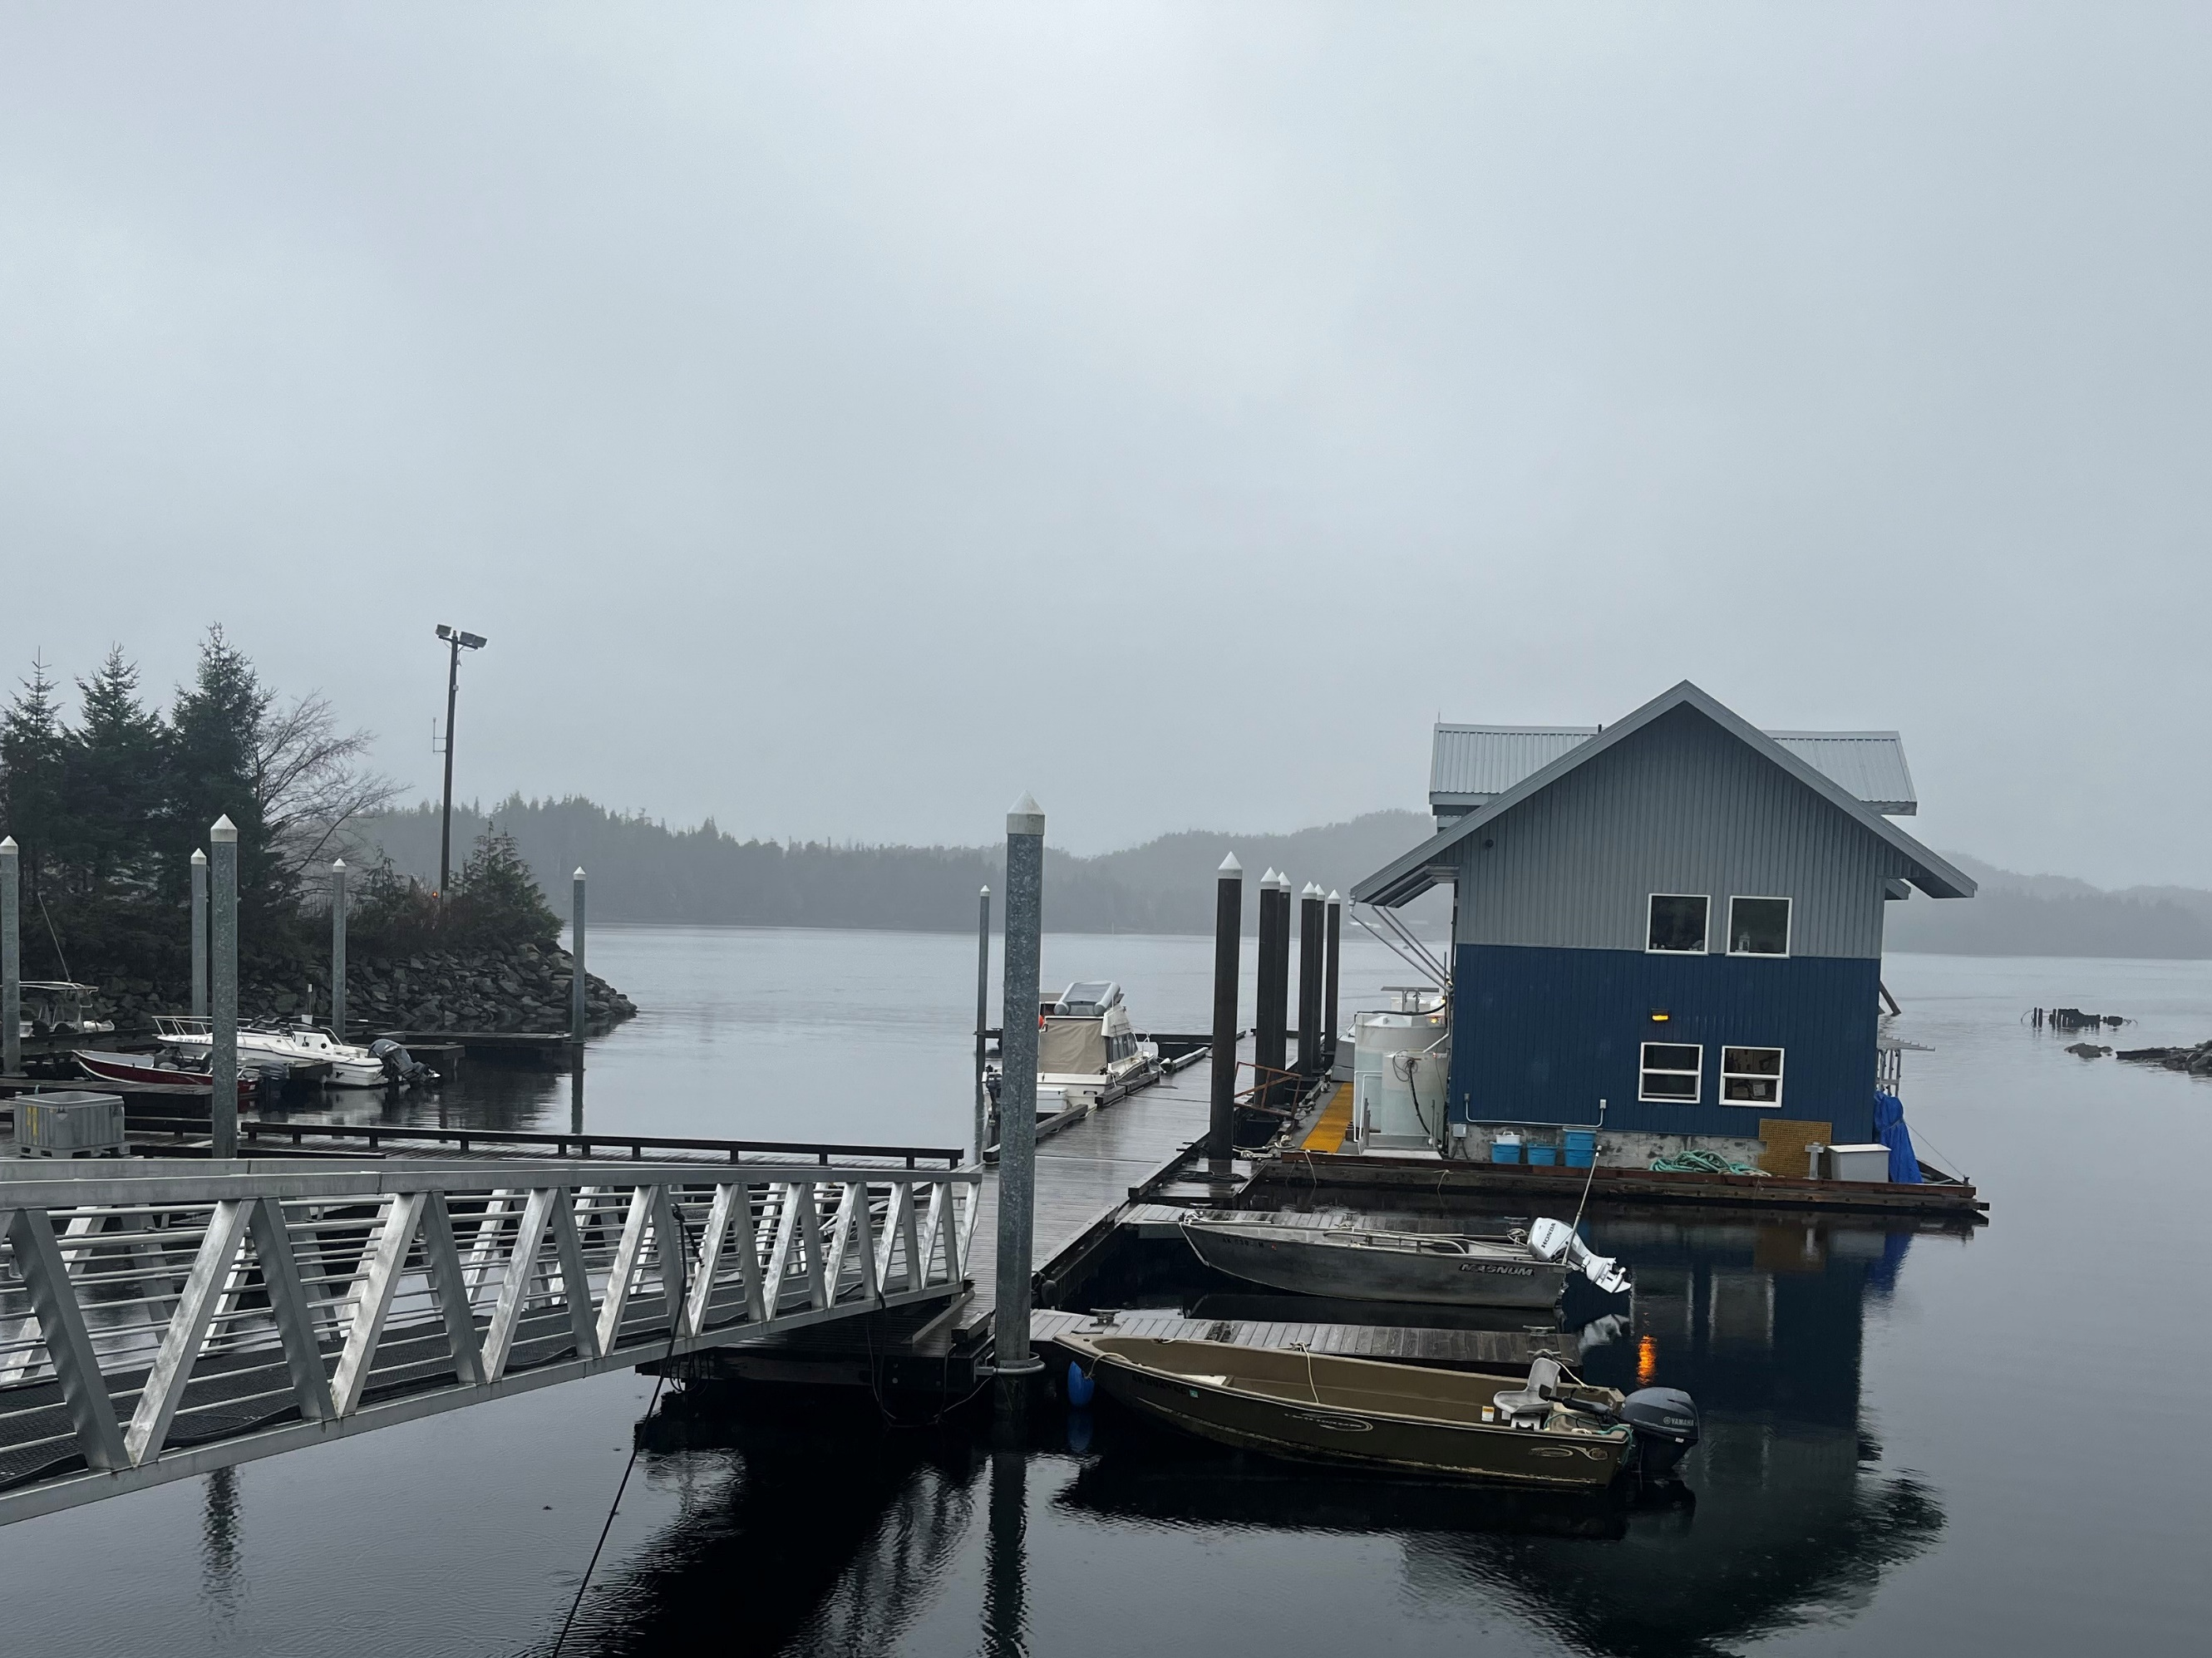
Component Projects + Sub Recipients
Governance, Coordination & Outreach
Workforce
Development
Research & Development
Equipment & Technology
RLF
Marketing
Green Energy
Spruce Root
TCFU
AMA
KPEDD
PWSEDD
SWAMC
UAA
UAS
UAF
AFDF
ADF&G
SEC
AFDF
ADEC
SEC

Slide 7
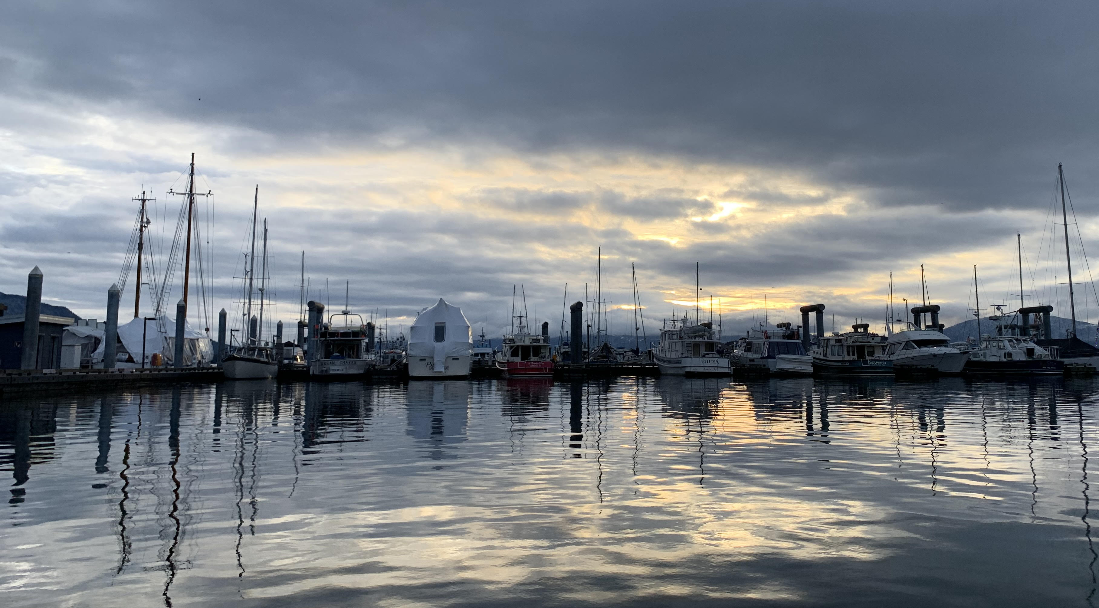
Project Descriptions
RLF (Revolving Loan Fund)
Governance, Coordination & Outreach
Workforce
Development
Research & Development
Equipment & Technology
Marketing
Green Energy
Start-up Capital
Broader Collateral Definitions
Gap Financing
Technical Assistance (Native Conservancy)
Governance Body
Communications & Engagement Plan/ Implementation
Regional Outreach Liaisons
New Curriculum & Certificate Programs at UAS, UAA, & UAF
Hands-on Training
Oyster & Seaweed Training Manuals
Knowledge Exchange
Seaweed Tissue Analysis
Product Development R&D
Joint Innovation Projects
Annual Conference
Carbon Sequestration R&D
B2B & B2C Market Research
Development of Buyer’s Guides & Other Assets
Marketing Program Implementation
Long-Term Green Energy Plan
Collect Energy Data
Create Analysis & Recommendations
“Best Practices” Guide
Feasibility Studies
Processing & Hatcheries Equipment Purchases
PSP Lab Equipment for ADEC
Seed Supply, Site Selection, & Monitoring

Slide 8
Project #2 Governance, Coordination and Outreach KPEDD, PWSEDD, SWAMC, AMA
This component addresses the need for governance, coordination and outreach relating to the resources of the BBBRC as well as public engagement and education relating to the developing industry
A Governance Body is overseeing the equitable and sustainable distribution of BBBRC resources and serve as a platform to receive and incorporate community feedback relating to the grant and general mariculture development
Next Governance Body Meeting is April 15, 2024

Slide 9
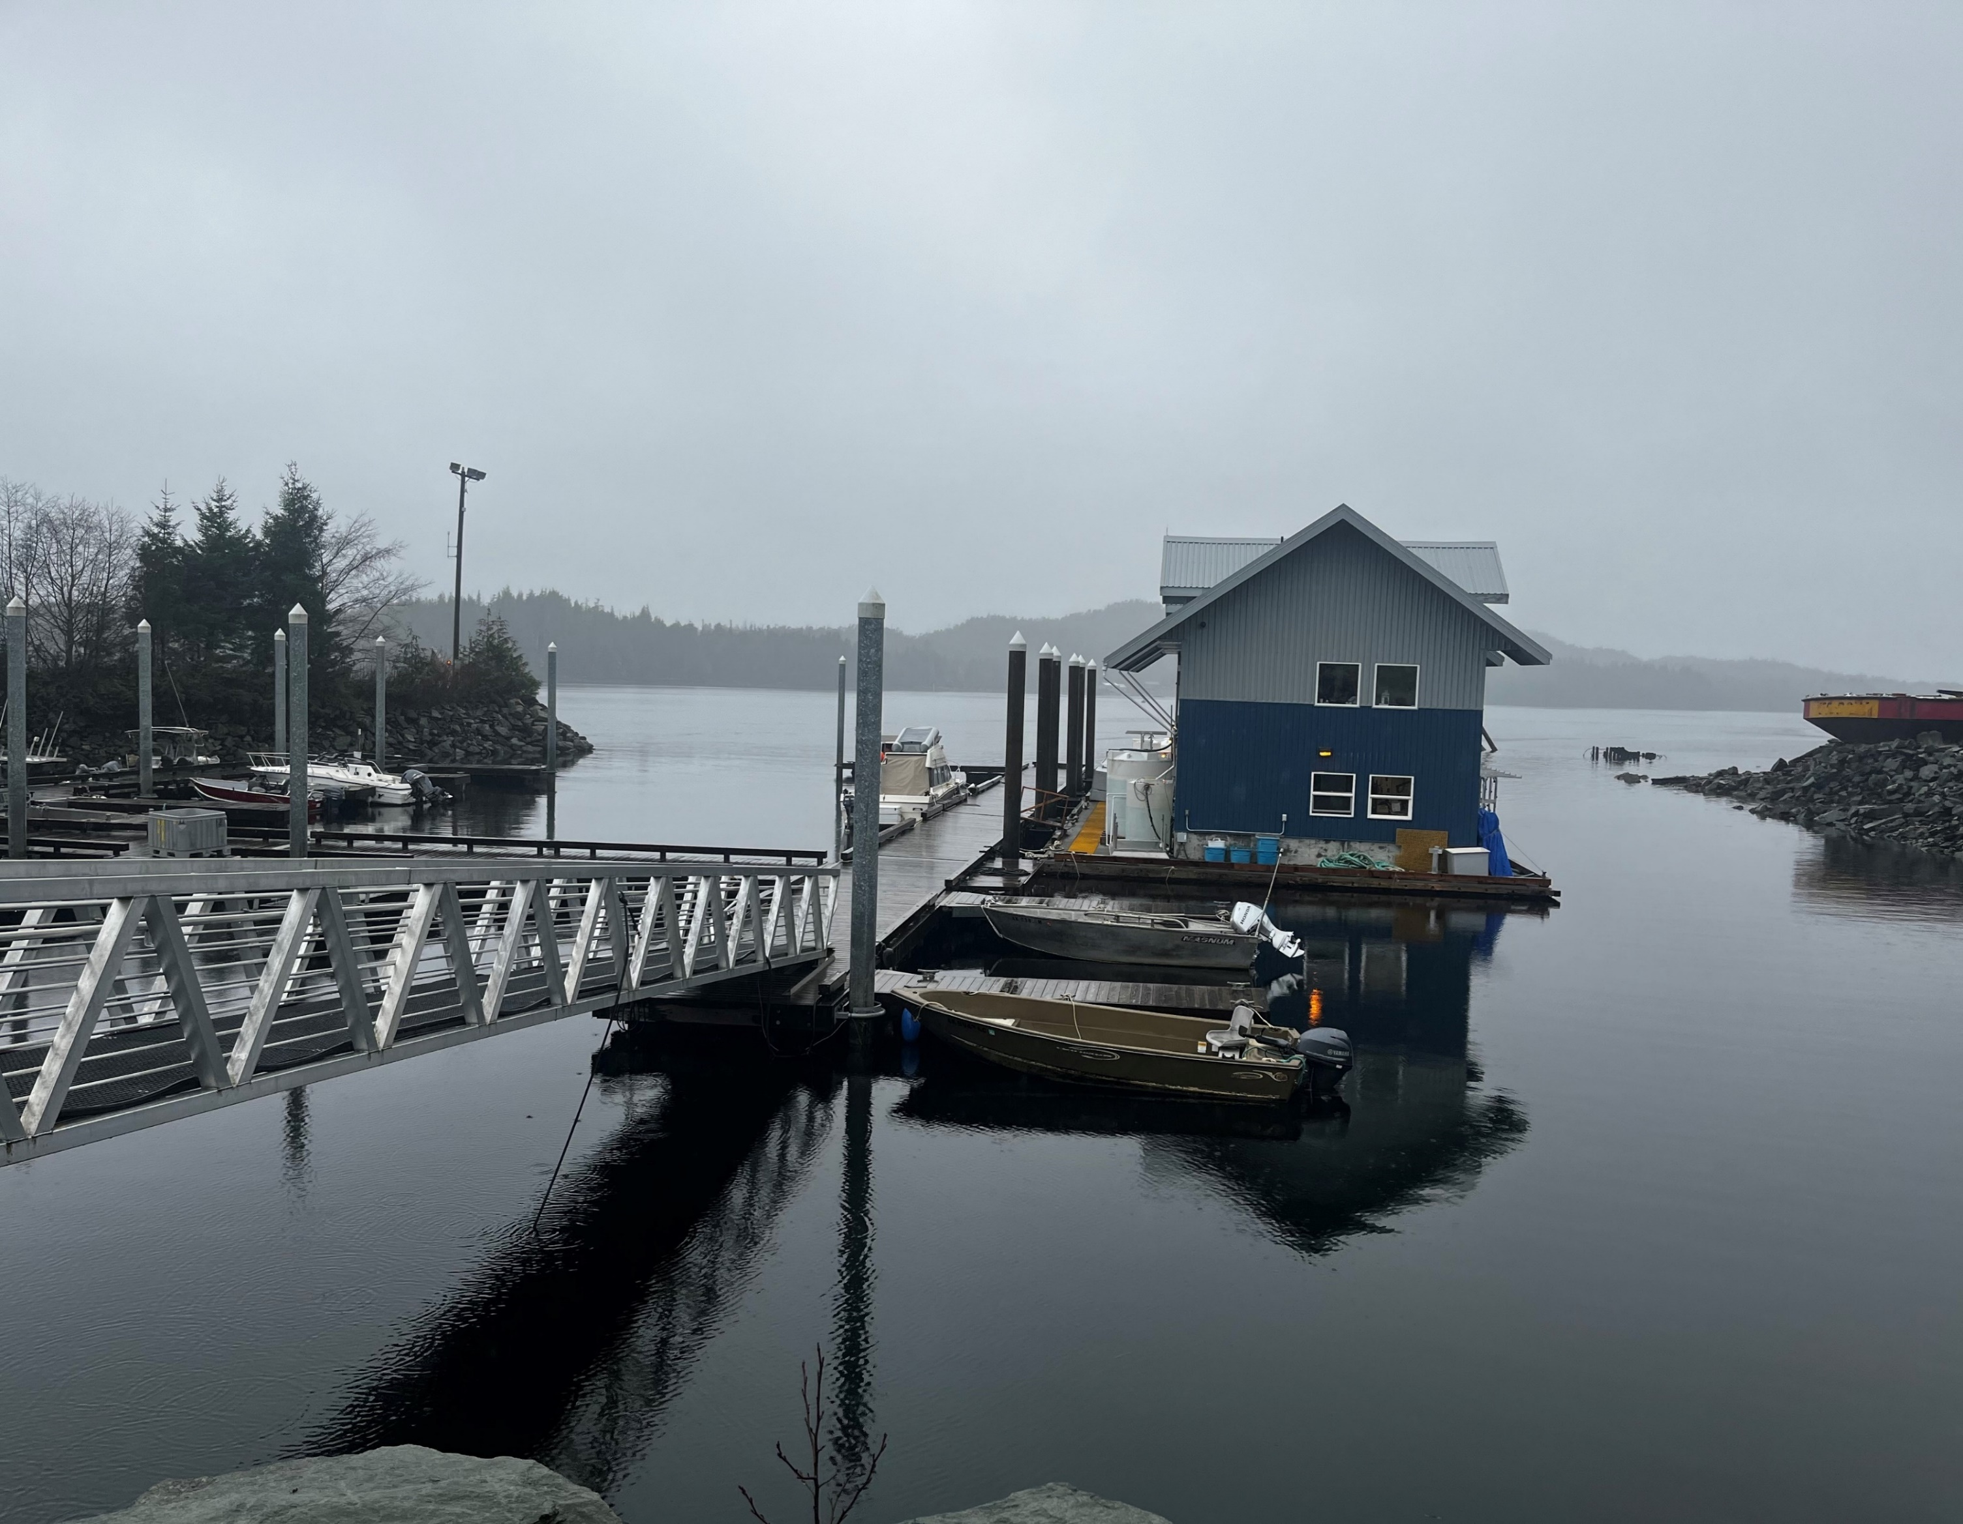
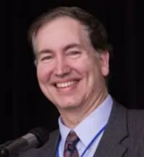
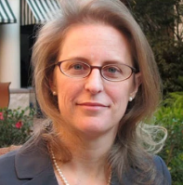
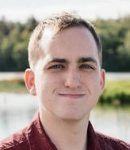
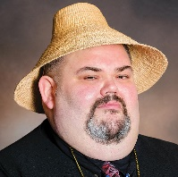
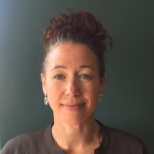
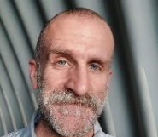
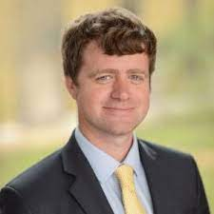
Governance Body
SOUTHEAST ALASKA
SOUTHWEST
ALASKA
KENAI &
PRINCE WILLIAM SOUND
INDUSTRY PARTNERS
Fishing Industry
SOUTHEAST CONFERENCE
SOUTHWEST ALASKA MUNCIPAL CONFERENCE
PWS ECONOMIC DEVELOPMENT DISTRICT
JULIE DECKER
PSPA President
ROBERT VENABLES
Executive Director
DAVID NELSON
Executive Director
KRISTIN CARPENTER
Executive Director
TLINGIT & HADIA
KONIAG NATIVE CORPORATION
KENAI PENINSULA ECONOMIC DEVELOPMENT DISTRICT
ALASKA MARICULTURE ALLIANCE
RICHARD
PETERSON
President
TOM PANAMAROFF
Regional & Legislative Affairs Exec.
CASSIDI CAMERON
Executive Director
JASON LESSARD
Executive Director
HEATHER MCCARTY
Baard President
THE ALEUT CORPORATION
CHUGACH ALASKA CORPORATION
THEA THOMAS
Board Member
MARKOS SCHEER
Board Treasurer
ECONOMIC DEVELOPMENT DISTRICTS
CHASE BERENSON
General Manager
JOSIE HICKEL
President
TRIBAL ORGANIZATIONS
AGENCY PARTNERS

Slide 10
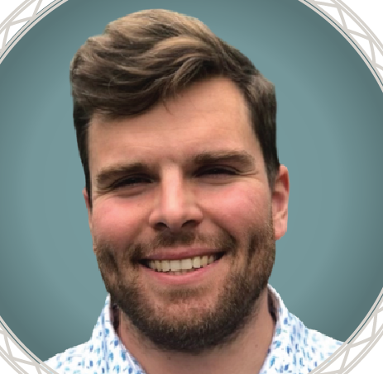
Tribal Mariculture Liaisons
SOUTHEAST ALASKA
SOUTHWEST ALASKA
KODIAK
PRINCE WILLIAM SOUND
KENAI PENINSULA
KODIAK ARCHIPELAGO LEADERSHIP INSTITUTE
QAWALANGIN TRIBE OF UNALASKA
CHUGACH REGIONAL RESOURCES COMMISSION
SPRUCE ROOT, INC.
CHUGACH REGIONAL RESOURCES COMMISSION
Keolani Booth
keobooth@live.com
Shayla Shaishnikoff
shayla@qawalangin.com
Lexa Meyer
lexameyer.kali @gmail.com
Briana Murphy
Briana
@alutiiqprideak.org
Sean Den Adel
sean@alutiiqprideak.org

Slide 11
Project #1 Revolving Loan Fund SEC, Spruce Root
The AMC RLF will address lending barriers within the industry and leverage capital to support rural and underserved communities interested in entering or expanding within the industry.
Spruce Root, an Alaska Native-owned 501(c)(3) nonprofit Community Development Financial Institution (CDFI), will be administering at least 50% of the RLF funds targeted towards underserved and Alaska Native participants
Spruce Root will be providing TA through existing resources and a partnership with The Native Conservancy
The AMC RLF will address gaps in lending through:
Start-up loans for first-time farmers, processors and new businesses
Expansion capital or fixed asset purchases
Bridge loans
Collateral support and loan participation
Notes:
SEC is partnering with Spruce Root to roll out the RLF program. The agreement has been signed and the goal is to have the program up and running sometime this summer 2024.

Slide 12
Project #4 Research and Development AFDF, ADF&G
Seaweed Tissue Analysis
Product Research & Development
Seaweed Genetic Diversity Analysis- ADFG collecting samples
De-risk Investments in Aquatic Farming
Carbon sequestration feasibility
Annual Conference (February 26-29, 2024)
Notes:
Seaweed Tissue Analysis through AFDF and a Sea Grant Fellow are collecting samples and working to fine tune a list of wild and currently cultivated species to sample. They’re developing a sampling plan with the goal of getting the first wild and cultivated samples in April.
De-risking Farm Investment is being coordinated with NOAA’s Aquaculture Opportunity Areas (AOA). After discussions with NOAA and other researched, they’ve decided to focus a large part of this effort on expanding the EVOs efforts by funding the mariculture production data collection in Southeast.
Carbon sequestration – coming soon

Slide 13
Project #4 Research and Development continued….
Fish and Game
Oyster Tissue Analysis
Joint Innovation Projects (AFDF)
$1.3 million awarded
15 projects
Another round of Joint Innovation Projects to be issued this spring
Notes:
Fish and Game has hired staff, trained their lab team to be able to conduct genetic tissue analysis of different species of seaweed.
They’re also in the process of designing and ordering a computer cluster to store all the genome data from these projects.
SEC is contracting with an instate organization to conduct oyster tissue analysis.
JIPS

Slide 14
Joint Innovation Projects
R&D Component
15 projects funded, $1.3 million awarded in 2023
Innovations in bull kelp cultivation: 2
Shellfish enhancement: 2
Innovations in mooring system tech: 1
Boosting oyster growth: 3
Innovations in stabilization/processing/product development (seaweed): 7

Slide 15
Project #5 Market Development
Cultivating markets and creating brand awareness for Alaska shellfish and kelp products
Contracting with Food for Climate League for market research of the mariculture industry
Notes:
Food for Climate League is conducting market research for the mariculture industry in Alaska. They’ve been interviewing business owners, farmers, and consumers around the state. Hosting stakeholder meetings once a month and comparing Alaska to the mariculture industry internationally.
SEC has contracted with an instate organization to work on marketing services regarding Prop 65

Slide 16
Project #6 Green Energy
Incorporating Green Energy into Alaska’s developing mariculture industry (RFP)
Establish baseline quantifying current energy use patterns
Develop a green energy plan
Develop best-practices guide for future energy audits and efficiency work
RFP awarded to UA team
Green Energy Mariculture Site
$800 stipend for participating farmers in 2024!
Notes:
https://www.uaf.edu/bbc/academics/sustainable-energy/Green%20Energy%20in%20Mariculture.php
Green Energy Mariculture
The UA team is going to:
Establish baseline quantifying current energy use patterns
Develop a green energy plan
Develop best-practices guide for future energy audits and efficiency work

Slide 17
Equipment & Tech
$15 million
S C O P E OF W O R K:
$9 million Equipment Purchases:
$4 million – nursery/hatchery equipment
Algae production systems, kelp hatchery equipment and supplies, oyster FLUPSYs, oyster and shellfish nursery equipment and supplies, etc.
$3 million – processing equipment
Kelp primary processing - drying, etc.
Oyster tumbling, sorting
Freezing, cooling, materials handling, etc.
$2 million – DEC toxin testing equipment
$16 million EDA grant funds
$9 million equipment purchases (SEC)
$6 million subawards & contracts
4 RFPs Initiated + Feasibility Study- $1M (funded) + Equipment- $5.75M (requested in first round)
+ Other Species- $650K (requested)
+ Economic Services- (published)

Slide 18
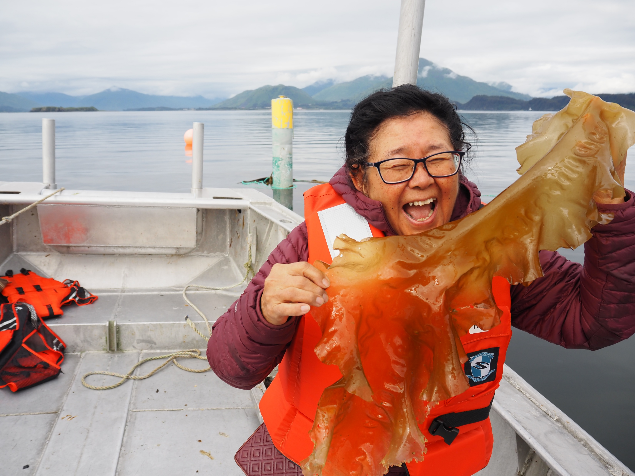
PROJECT HIGHLIGHTS
40
STUDENTS
currently enrolled in UA’s
BBB Mariculture Programs
+$5M
In new projects
Awarded in 2023
+$6.5M
Requested
in 2024
Notes:
add Other Mariculture Species and number of contracts going to tribes

Slide 19
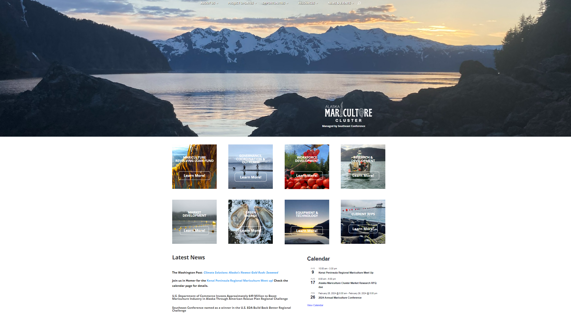
Check out our website AlaskaMariculturecluster.org for more information and stay up-to-date on opportunities to get involved!

Slide 20
Robert Venables SEC Executive Director Robert@seconference.org
Check for updates and join our mailing list:
www.alaskamariculturecluster.org

