Slide 1

AML
Infrastructure Activities
March 2024
SWAMC
Economic Summit
Erin Reinders, AML’s Director of Infrastructure Development
Notes:
AML is a nonprofit member organization established in 1950, has a long history of directly supporting Alaska’s 165 cities and boroughs. This is accomplished through shared services, annual conferences and symposiums, ongoing communication with and advocacy for our members, and responsive technical assistance and training opportunities.
In the past couple of years, AML has stepped up efforts in respond to the Bipartisan Infrastructure Law, (and then the Inflation Reduction Act) with the goal of bringing as much benefit to Alaskan communities as possible.
I’ll quickly go over some of those efforts today. AML is currently delivering multiple programs in this energy space including:

Slide 2

Grant Writing
and Project Management
Augment
Capacity
Increase Competitiveness
Bundle Projects and Data
OUR APPROACH
Improve Community Conditions
Deliver Funding and Projects
Strengthen Local Governments
Connect to Tools and Services
Notes:
How can we think about AML’s approach as a member organization?
The scale and scope of federal funding for infrastructure opportunities is immense and overwhelming. But this is our approach to help!
Overarching Goal:
Maximize the benefit to Alaska and foster statewide collaboration, especially with all the opportunities coming from the Bipartisan Infrastructure Law.
Help position local governments for success by being a resource for partnerships, information, and guidance. We recognize that capacity is a hurdle for many and want to augment that.

Slide 3
Cohort Support
OUR IMPACT
Notes:
Our outcomes…Available resources and support
So, how does our approach impact each of you, what are the outcomes of those approaches?
Mixture of outreach and information sharing - emails, informational hubs, websites, weekly infrastructure office hours
Access to training, and Technical Assistance – conferences, connections to specialists, training opportunities (asset management sessions we are having this year as an example), governance assistance
Cohort support – I imagine we will be seeing more and more of these – some of you may have heard about Alaska Water Infrastructure Navigation Center and the associated Cohort Groups – we also have a Safe Streets for All working groups all focused on implementation of the same grant
Direct support - like grant writing

Slide 4

Title
Here
INFRASTRUCTURE PROGRAMS
Capacity Building
Infrastructure and Grant Writing
Grant Writing
Grant writing for all local governments, especially in disadvantaged communities.
Grant writing for all disadvantaged communities.
Title
Description goes here.
Infrastructure Coordination
Heavy Equipment CDS
Bundled delivery of heavy equipment for eight communities.
Legislative support for AML coordination of information sharing, engagement, grant assistance and review. Hosting annual Infrastructure Symposium and akfederalfunding.org.
Title
Community Benefits
Description goes here.
Project manager for grants requiring capacity building, workforce development, and stakeholder engagement.
COPS - Police Standards
Collaborate with AACOP to develop Alaska accreditation.
Notes:
We try to add to the capacity of local governments :
Assisting with Grant writing
Host annual Infrastructure Symposium – this will be held on April 2 – 4, with the Delegation Grants Symposium on the 5th.
Project manager for grants requiring capacity building, workforce development, and stakeholder engagement.
Helped to bundle Congression Directed Spending request for Heavy equipment.

Slide 5
Title
Here
INFRASTRUCTURE PROGRAMS
Transportation
EV Deployment in Rural Alaska
SMART
Community engagement in DOT&PF drone program.
AEA program to support rural community planning and implementation of EV charging stations.
Title
Description goes here.
Task 1 - Transportation Hub
Task 2 - Grant writing
AML-managed review of local transportation projects matched with federal opportunities and resources.
DOT&PF support for transportation grant-writing.
Title
SECCAP - Transportation
SECCAP - Transit
Description goes here.
Statewide transportation equity planning.
Statewide transit equity planning
Regional Infrastructure Accelerator
SS4A
Development of TIFIA and RRIF plan for Alaska, with PNWER.
Bundled development of community safety action plans.
Notes:
AML continues our relationship with state dot to both support transportation related projects and applications, and to assist with connecting more with local community priorities in the process.
We are working with PNWER to try help increase the usage of TIFIA loan opportunities to help fund transportation projects in Alaska. We are working with a community engagement related to EV deployment in rural Alaska.
The next couple of slides really helped to celebrate some of our transportation related successes and activities in the SWAMC region in particular

Slide 6
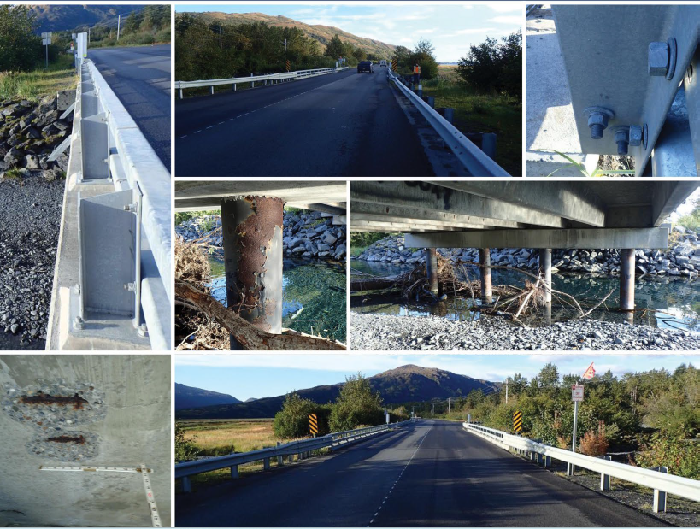
BIP Planning – Kodiak Sargent Creek and Russian River Bridges Planning Study
  Awarded $1.28 million
  Owned by State, Applied for by Borough.
These two bridges are critical structures in regard to the daily transportation for residential, commercial and industrial access for the population of Kodiak.
  This grant would fund a Planning and Environmental Linkage (PEL) Study, a Hydrologic Study and fund other planning activities necessary to replace two bridges on an important state highway on Kodiak Island and make recommendations for other infrastructure improvements to mitigate flooding in the area.
  .
SUCCESSFUL COLLABORATION
Notes:
2022 Bridge Investment Program (BIP)
This was a need that came from the borough, related to two state owned bridges. State, AML and Boroughs supported the application. It was more competitive to have the local government apply, and to bundle these bridges. the Borough was the formal applicant, for this State project.

Slide 7
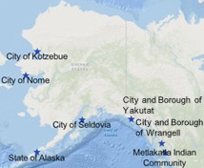
PIDP – Cold Bay Dock
  Awarded $43M for Cold Bay Replacement Dock.
  Owned by Borough, Managed by City, Applied for by State.
  This is the community’s only existing dock, which is nearing the end of its useful service life.
  As the town’s only marine connection, the new dock will be designed and built to accommodate commercial use, freight and fuel transportation, private vessel use, and public uses like emergency medical services and AMHS.
SUCCESSFUL COLLABORATION
Notes:
Port Infrastructure Development Program Grant
$43 million dollar has been awarded for the Cold Bay Replacement Dock.
Capacity and match can be a huge a challenge for communities This grant was successful because of the close collaboration between Aleutians East Borough, City of Cold Bay and the State of Alaska – DOT. This is a Borough owned and city manager facility. The State- recognizing this project’s importance supported the application not only by applying but by committing to the match. AML was very excited to assist and Coordinate !
Capacity is a challenge – connect borough, cities and State – offer direct support with grant writing and review
7 communities were successful in Port Improvement Development Program (PIDP) awards this year, Congrats to all!
AML assisted with 3 of those in different ways.
– applications for Cold Bay Dock, for Seldovia, and for Yakutat.

Slide 8
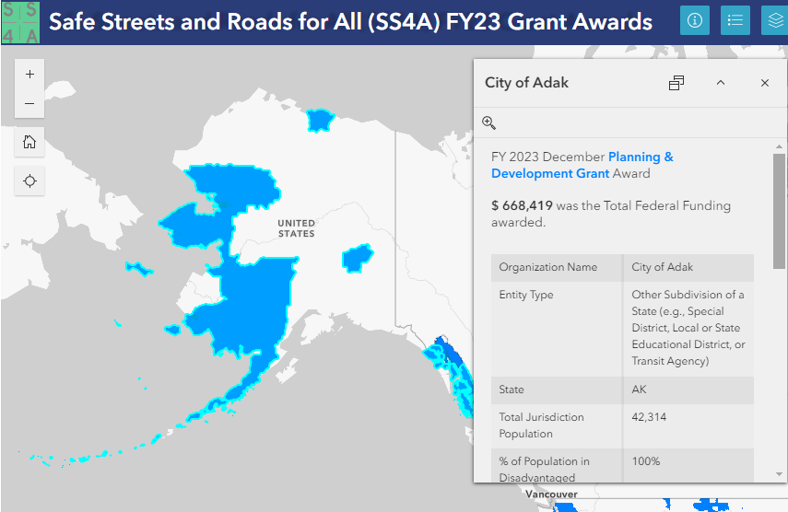
WORKING GROUPS
2022 - City of Saint Paul (and Saint George)!
Notes:
Saint Paul was one of 7 communities in Alaska that was awarded funding to from the 2022 Safe Streets for All, each working on Safety Action Plans. These action plans will qualify these communities for implementation grants in the future.
AML hosts a monthly meeting open to all these communities so they may compare notes and learn from each other. So far that have shared what their experiences have been in the grant agreement process, and lessons learned. Saint Paul is kind of a rock star with this program and it really taking the lead within this group, they have been neighborly enough to share their RFP’s to help the others along in their processes.
ONE TO MANY NOTES

Slide 9
Title
Here
INFRASTRUCTURE PROGRAMS
Broadband
BEAD
Digital Equity Coalition
FCC ACP
Advancing role of Community Anchor Institutions and supporting local government engagement.
Outreach and engagement with communities to promote utilization of federal subsidy.
Title
Description goes here.
Host of a coalition of organizations dedicated to advancing digital equity in Alaska, ensuring affordable and equitable access to devices, learning, and programs. Program support and advocacy that promotes beneficial outcomes for communities.
Digital Equity
Cybersecurity
Title
Description goes here.
Hosting listening sessions in member communities and contributing to Alaska’s Digital Equity Plan.
Contribute to Alaska’s Cybersecurity Plan and support implementation of local cybersecurity grants.
Notes:
NOTES

Slide 10
INFRASTRUCTURE PROGRAMS
ENERGY
Repurposing
Energy Assets
Arctic Energy Ambassadors
Energy Futures
Support 12 Ambassadors across Alaska regions to
facilitate project development and technical assistance.
Municipal code and financials.
Tribal Grid Resilience
EECBG
Rural Energy Conference
Formula funding support for Tribes to fund utility improvements.
Energy audits and planning
in 8 communities.
2024
AK Energy Hub
AK Energy Hub
Solar for All
Energy intake
form and website development.
Phase II – Technical assistance and project application support.
Community and residential solar deployment.
Energyshed Tech Stack
Building Codes
Development of at least 3 energy projects in NW and SE Alaska
valued at $10 million for private investment.
Facilitate local code development with AHFC.
Notes:
We are doing more and more in the energy space now -
Host of the Alaska Energy Hub,
Partnering with the DOE’s Arctic Energy Office and Denali Commission on the Arctic Energy Ambassador Program
Partnering on an Energyshed project in two regions of the state, and
Serving as Administrator of an EECBG award delivering benefits to 8 communities
I want to touch on a few of these as they impact each of you and the SWAMC Region…

Slide 11
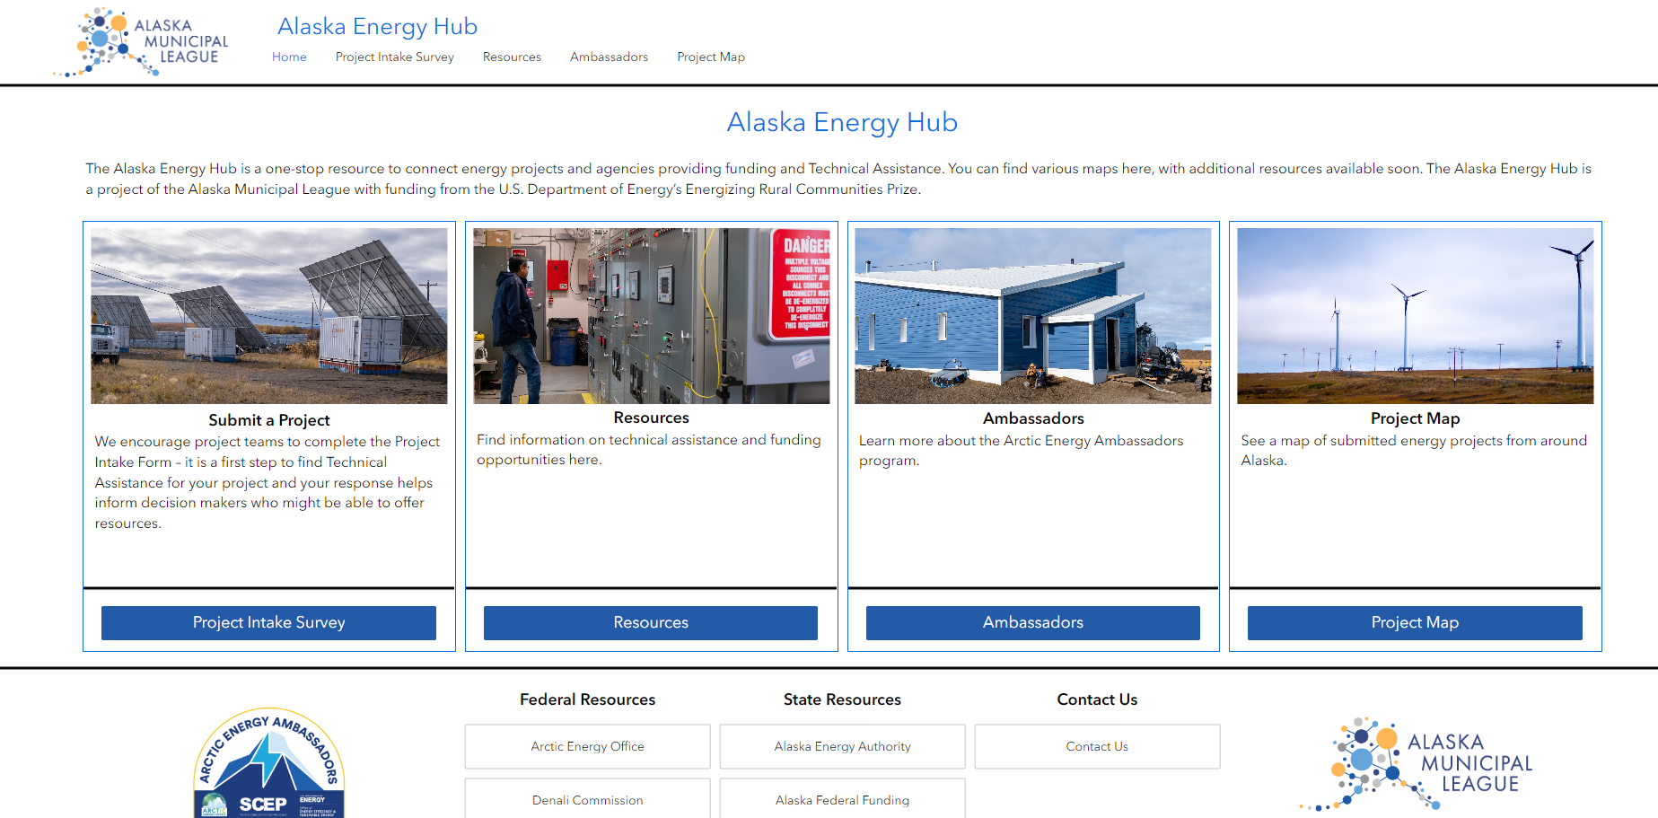
Alaska Energy Hub
akml.org/energyhub
Notes:
With funding from the U.S. Department of Energy Office of Clean Energy Demonstrations’ (OCED) Energizing Rural Communities Prize, we have launched the Alaska Energy Hub, a one-stop resource to facilitate the development of energy projects in the state. akml.org/energyhub
The Energy Hub makes it easier for communities developing energy projects to connect with technical assistance providers and funding agencies, with the goal ensuring greater impact of federal funding to make Alaska’s energy infrastructure more affordable and sustainable.
It includes:
project intake form (to communicate your project idea and to be considered for technical assistance and help with identifying potential grant opportunities),
project map (which allows potential funders and agencies to see what projects are being contemplated, can be used to see explore bundling or collaboration possibilities),
resources on technical assistance providers and a interactive map of existing energy projects), and
information about the Arctic Energy Ambassador Program and the recently announced ambassadors

Slide 12
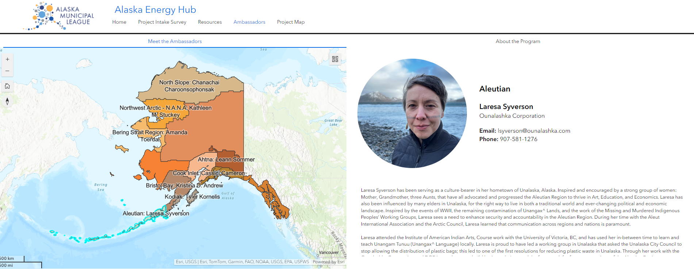

Arctic Energy Ambassadors
Goal 1: Articulate community and regional energy needs through a cohort of local champions.
Goal 2: Connect stakeholders and promote professional and regional capacity development through ongoing DOE training and engagement.
Goal 3: Provide regional technical assistance to advance project development.
Goal 4: Develop regional or statewide projects, with solutions to energy issues that could be replicated throughout the Arctic.
Goal 5: Encourage regional projects championed by Ambassadors to be vetted through an online energy project portal created to better connect stakeholders to funding opportunities (including key application deadlines) and technical resources.
Notes:
Partnering with the DOE’s Arctic Energy Office and Denali Commission on the Arctic Energy Ambassador Program. This program just kicked off in January, with our first meeting with the Ambassadors.
The program goal is to foster energy security and advance the clean energy transition across the state. Developed in alignment with the U.S. Department of Energy’s Arctic Strategy, the program will cultivate regional, place-based, and collaborative energy leadership. Ambassadors will benefit through shared resources, knowledge-sharing partnerships, and access to technical assistance, to help drive sustainable projects across Alaska.
12 ambassadors – 1 for each region based on the AncSa regions – have been selected to participate.
Ambassadors will be tasked with articulating community and regional needs, connecting stakeholders, promoting capacity development, facilitating regional technical assistance, and identifying projects.
I wanted to introduce you all to the Arctic Energy Ambassadors in the SWAMC region. You may recognize some of these faces! Please reach out to them!
Laresa Syverson is the Energy Ambassadors for the Aleutian Region.

Slide 13
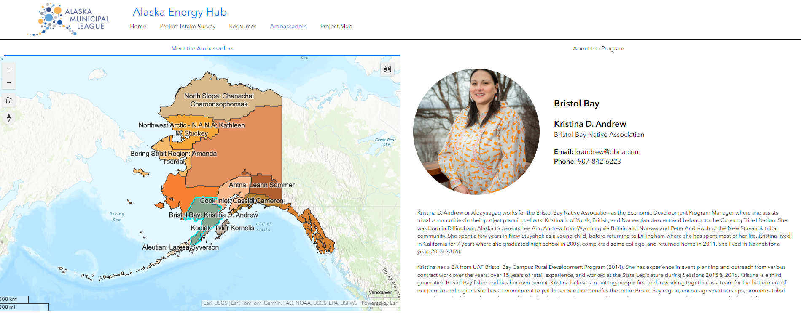
Arctic Energy Ambassadors
Goal 1: Articulate community and regional energy needs through a cohort of local champions.
Goal 2: Connect stakeholders and promote professional and regional capacity development through ongoing DOE training and engagement.
Goal 3: Provide regional technical assistance to advance project development.
Goal 4: Develop regional or statewide projects, with solutions to energy issues that could be replicated throughout the Arctic.
Goal 5: Encourage regional projects championed by Ambassadors to be vetted through an online energy project portal created to better connect stakeholders to funding opportunities (including key application deadlines) and technical resources.
Notes:
Kristina Andrew of the Bristol Bay Native Association is the Ambassador for the Bristol Bay Region

Slide 14
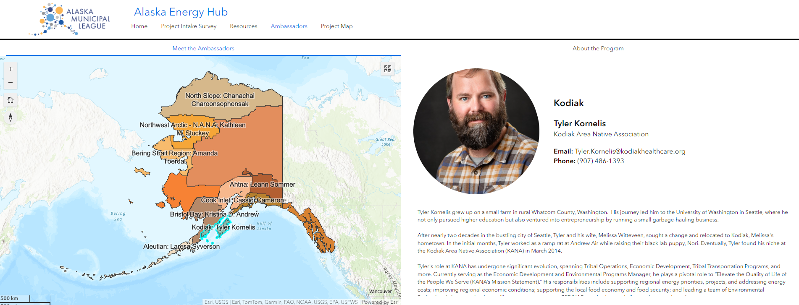
Arctic Energy Ambassadors
Goal 1: Articulate community and regional energy needs through a cohort of local champions.
Goal 2: Connect stakeholders and promote professional and regional capacity development through ongoing DOE training and engagement.
Goal 3: Provide regional technical assistance to advance project development.
Goal 4: Develop regional or statewide projects, with solutions to energy issues that could be replicated throughout the Arctic.
Goal 5: Encourage regional projects championed by Ambassadors to be vetted through an online energy project portal created to better connect stakeholders to funding opportunities (including key application deadlines) and technical resources.
Notes:
Tyler Kornelis with the Kodiak Area Native Association is the ambassador for the Kodiak Region

Slide 15
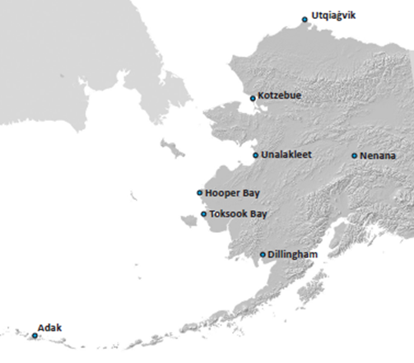
EECBG
  One of 12 other awardees in the nation to support the implementation of energy improvements.
  $900,000 going to Nenana as lead applicant.
  Will help 8 communities!
  AML will manage the project and facilitate technical expertise from additional partners.
  Energy Audits for public buildings and support improvements.
Energy Efficiency and Conservation Block Grant
Notes:
The City of Nenana was awarded funding through EECBG with this bundled application, and Alaska Municipal League will help to manage the project and facilitate technical expertise from additional partners.
This project will result in energy assessments and efficiency & conservation plans for public facilities in 8 - including Adak and Dillingham - communities. The project will:
increase energy efficiency
reduce diesel fuel consumption, and
lead to more economically delivered power to community facilities.
At the end of the project period, communities will have prioritized recommended energy efficiency and conservation actions and initiated progress toward at least one of those priorities in each community.

Slide 16
Title
Here
INFRASTRUCTURE PROGRAMS
Resilience
CPRP – GHG
and CAP
Preliminary CAP - CAA IRA 103
Prepare State for Carbon Pollution Reduction Program.
Title
Description goes here.
Manage DEC implementation of EPA’s Carbon Pollution Reduction Program, including to develop statewide greenhouse gas emissions inventory. Work with communities to identify potential projects as part of State plan, to become eligible for competitive funding to strengthen grids and lower costs.
EJCPS
Complete health impact assessments and climate resilience plans in 25 communities, to strengthen competitiveness in applying for federal investments.
Coastal Resilience Consortium
Development of statewide coastal resilience network that focuses on municipal interests and responsibilities.
Notes:
AML is helping Alaska’s DEC with EPA’s Carbon Pollution Reduction (CPRG) Program, including to develop statewide greenhouse gas emissions inventory, and the development the State’s Priority and Comprehensive Sustainable Energy Plans. This includes working with communities and state agencies to identify potential projects or types of projects to include as part of State plan, to become eligible for competitive funding to strengthen grids and lower costs.
So that’s the planning side, there is also implementation funding opportunity. CPRG is offering $4.6 billion in implementation grants for key infrastructure, with a tribal set-aside and no required match.
Available to state agencies, local governments, and tribes to implement measures named in Priority Plan.
General competition deadline is April 1, 2024 and Tribal and Territory completion competition is May 1, 2024.

Slide 17
Title
Here
INFRASTRUCTURE PROGRAMS
Water & Wastewater
AWIFNC
Advancing Alaska Water Workforce
Develop sector strategy for public sector water and wastewater utility workforce development.
Title
Description goes here.
USDA funded program to strengthen financial and governance in 10 communities, increase asset management, and share relevant resources.
AWIFNC
EPA funded program to strengthen financial and governance in 30 communities, increase asset management, and share relevant resources.
Notes:
Through our Alaska Water Infrastructure Financial Navigation Center …we will be providing
Asset management training and tools development
Provide resources for funding opportunities
Technical assistance and training for project and grant development
Community resilience outreach and education – state programs
Financials and governance support – direct and indirect assistance

Slide 18
Thank you!
Erin Reinders, Director of Infrastructure Development
Erin@akml.org

