Slide 1
UNIVERSITY OF ALASKA
Southwest Alaska Municipal Conference
2024

Slide 2
UA
UA System
UA System
Three Universities, One System
16+
Colleges, campuses, and extension sites providing access statewide
400+
Breadth of programs from workforce credentialing to doctoral degrees
21K+
Students served across all six economic regions
Unique Missions Offering Diverse Value
2
Notes:
3

Slide 3
UA
UA System
Bristol Bay Campus
(UAF)
Faculty and staff work out of seven communities — encompassing the Bristol Bay and Aleutian Pribilof regions of southwest Alaska. The campus in Dillingham is one of five community campuses within UAF’s College of Rural and Community Development.
Wage Growth
One Year before Graduation | One Year after Graduation | Five Years after Graduation | Salary Increase (One Year to Five) | % Increase (One Year to Five)
$32,277 | $32,598 | $43,872 | $11,274 | 35%
In 2022 I was able to purchase a boat. It was my first time as the captain of my own boat and I had a successful season [referring to summer 2022]. That wouldn’t have been possible without the tribal entrepreneurship fisheries course I took, led by Laura Zimin.
-Ben Stichler, Tribal Entrepreneurship:
Fisheries student and Bristol Bay commercial fisherman
3

Slide 4
UA
UA System
(UAA)
Kodiak College Campus
Kodiak College (KoC) puts students first through innovation and individualization, and is responsive to community needs. Focusing on local and global connections, KoC is a student-centered, vibrant community of learners.
Wage Growth
One Year before Graduation | One Year after Graduation | Five Years after Graduation | Salary Increase (One Year to Five) | % Increase (One Year to Five)
$28,600 | $31,845 | $50,279 | $18,434 | 58%
The Kodiak College Maritime program provides an opportunity for its students to look more deeply into the critical systems that keep the fishing and boating community running. The program offers students a taste of the broad spectrum of skill sets required to do just that. There is enormous opportunity to work in support of the fishing community in Kodiak. I'm just so grateful words can not describe. Kodiak is a unique place that allows hard working people to excel and to feel like they are making a difference in the community. The Maritime program set me on just such a path.
-Garret Wright, Marine Service Technology Graduate
4

Slide 5
2023
UA WORKFORCE REPORTS
11 INDUSTRIES HIGHLIGHTED
Administration & Finance
Health
Mining
Construction
Hospitality & Tourism
Oil & Gas
Education
Information Technology
Transportation
Fisheries & Marine Science
Law & Public Safety
5
Notes:
We recently completed a project in partnership with Research and Analysis at the DOLWD to match graduates and their employment outcomes. As a state we are fortunate to have access to some of the best employment data in the country through Research and Analysis. The wage data in these workforce reports represent actual wages earned of university graduates who work and live in Alaska.
These workforce reports that highlight the university’s contributions to Alaska’s workforce across 11 industry sectors that are important to Alaska’s economy.
We’ve included a QR code so you can easily access the reports once the slides are shared.

Slide 6
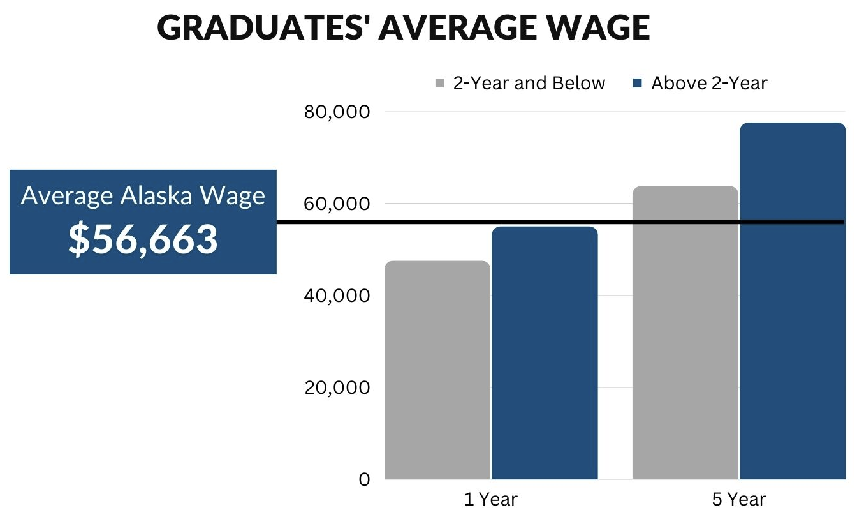
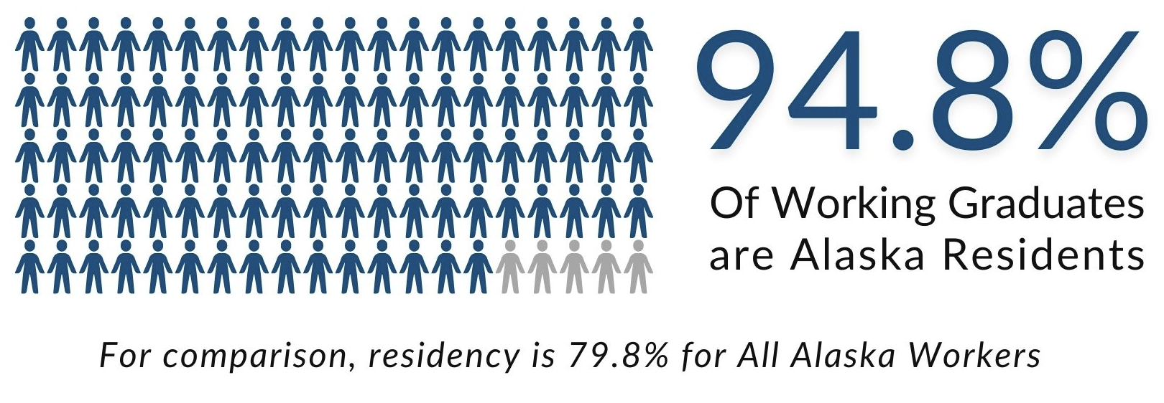
UA'S IMPACT ON ALASKA'S WORKFORCE
Since 2011
26,948
Students have graduated from programs relevant to the state’s high demand industries, producing the following outcomes:
BOOST ALASKA’S HIRE RATE
6
Notes:
This is a summary of the nearly 27K graduates employment outcomes represented in the 11 reports.
You can see that education pays – even for certificate and associate programs, graduates are out earning the average Alaska wage by their fifth year of employment.
The outcomes also highlight the importance of training our own – retaining talent in state with those who are committed to living in Alaska. While the percentages vary across the nine workforce reports, in every case the residency rate is higher for university graduates compared to the residency rate of all workers within each industry sector.
This graph represents wage outcomes earned over a 10-year period of the graduates across different levels of certificates and degrees.

Slide 7
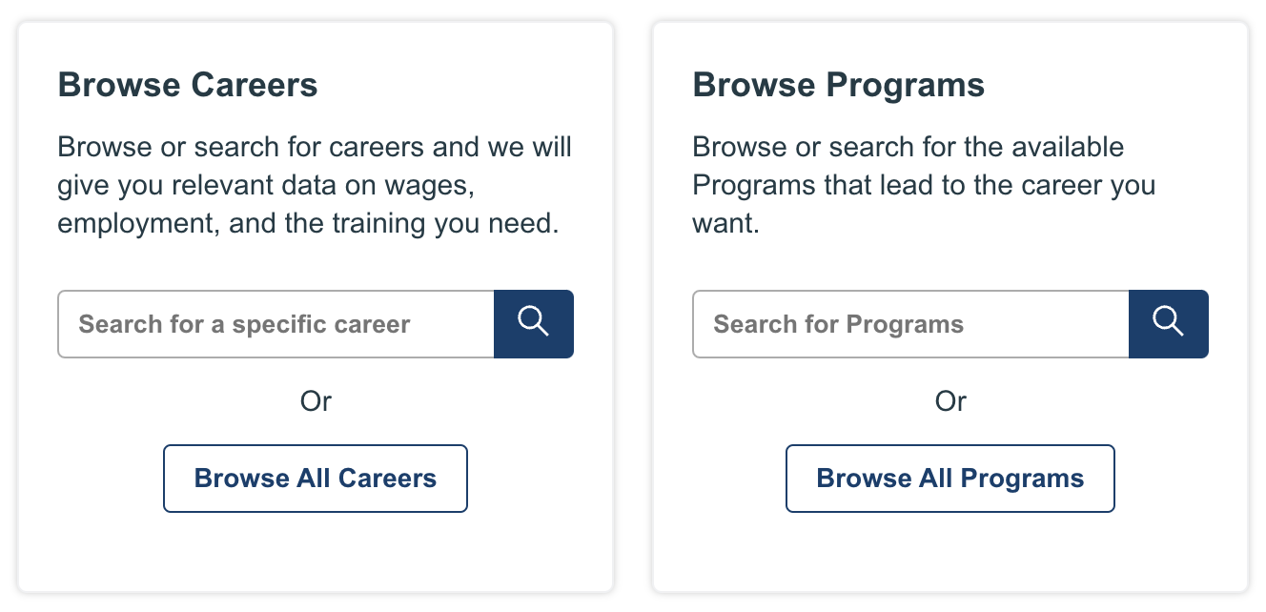
CAREER COACH
In the last six months…
CONNECTING STUDENTS TO
HIGH-DEMAND JOBS THROUGH
UA PROGRAMS
4,555
815
Students can make connections between UA programs and careers based on their interests and the job market in Alaska.
Unique visitors viewed Career Coach
Career assessments completed
Top Five Career Searches
Welding
Computer Networking
Accounting
Pilot
Nursing
7
Notes:
The University of Alaska is actively working to increase awareness of employment opportunities across Alaska and provide access to training. UA Career Coach is one of the tools utilized to achieve this.
The site uses real-time labor market information for careers and education in Alaska
Provides a Career Assessment or Interest Inventory for students or potential students to align their interests to careers
Careers linked directly to training programs and live job postings with direct links to apply
We would welcome the opportunity to provide an overview of this tool and how it might be helpful to those you’re working with.

Slide 8
70,000+ JOBS
In 150 Coastal Communities
maritimeworks.org
8
Notes:
Highlighting particular areas of interest to SWAMC members….
The Alaska Maritime WFD Plan was published in 2014 and since then there have been two Action agendas published to prioritize the ongoing work through 2025.
Just last week, a mariculture workforce plan was published and announced that coincides with these efforts.

Slide 9
UA
FSMI
Fisheries, Seafood, and Maritime Initiative
(FSMI)
Helping strengthen the maritime workforce and economy
Marine Occupation & Support Industries/ Alaska Maritime Education Consortium
Seafood Harvesting and Processing
Research, Enhancement & Management
Mariculture
9
Notes:
FSMI was launched to develop the initial workforce plan and the working groups identified here have been actively engaged to implement the goals and strategies in the plan and action agendas.
These long standing efforts, involving programs at all three universities and partnerships with AVTEC, Maritime Works at Alaska Safety Alliance who is helping to coordinate these efforts, Alaska Research Consortium, and many others.

Slide 10
UA
AMEC
Alaska Maritime Education Consortium
(AMEC)
Mission
Vision
Collaborating to prepare Alaskans for afloat and ashore careers that will support and strengthen the maritime workforce
Alaskans Fulfilling the Workforce Needs of Alaska’s Maritime Economies
Expanding Access to Training
AMEC Training Partners
AVTEC Alaska Maritime Training Center
UAA Kachemak Bay Campus
UAA Kodiak College
UAA Prince William Sound College
UAF Bristol Bay Campus
UAS Ketchikan Maritime Training Center
Affiliate Members
10
Notes:
The Alaska Maritime Education Consortium is one of the working groups who formally came together and has received a federal designation as a Domestic Maritime Center of Excellence by the Dept. of Transportation Marine Administration.
Partners include UAF Bristol Bay Campus and Alaska Sea Grant and UAA Kodiak College serving the Southwest region of the state.
In 2023 AMEC trained 11 instructors from five of Alaska’s economic regions to deliver the Yamaha Marine Technician Training program and the program is now being launched at UAF BBC and UAA Kodiak College to expand training for outboard motor maintenance and repair.
AMEC is next turning their attention to expanding access to marine electrical and electronics training – another high-demand need for coastal communities.

Slide 11
UA
Training Needs
Alaska Sea Grant &
Partners
University of Alaska Fairbanks
Micro-credential Crew Classes
Developing Crew Apprenticeship Program
Ammonia Refrigeration
Baader Training
Seafood Processor Leadership Training
11
Notes:
While UAF Alaska Sea Grant has a statewide presence, specific to Southwest Alaska they deliver programs through the Kodiak Seafood and Marine Science Center, UAF Bristol Bay Campus, and in partnership with the Alaska Research Consortium.
These are examples of programs they have been delivering or helping to coordinate with industry partners, and those under development. Of note, this past year:
89 seafood processing supervisors were trained in Naknek and Dillingham
5 students received crew training at UAF Bristol Bay Campus
30 operators received ammonia refrigeration training at Kodiak Seafood and Marine Science Center

Slide 12
Preparing a qualified workforce is one of the most important missions of the university, and UA is committed to preparing today's students to be the next generation workforce and advance Alaska’s economy.
Paul Layer
Vice President of Academics, Students, and Research
pwlayer@alaska.edu
907.450.8018
12
alaska.edu/research
Notes:
8

